Slide 1





Environmental Science
Lesson 2: Science, Matter, Energy and Systems
Notes:
Copyright Grey's Digital Online, LLC 2020-present (usbiologyteaching.com)

Slide 2

The Nature of Science
___________________ is a broad field of study that is focused on discovering how nature works.
By building knowledge of science we can better describe what is likely to happen in a specific situation as we learn more.
Careful experimentation, ___________________, and measurements help us to develop an understanding of the natural world.

Slide 3
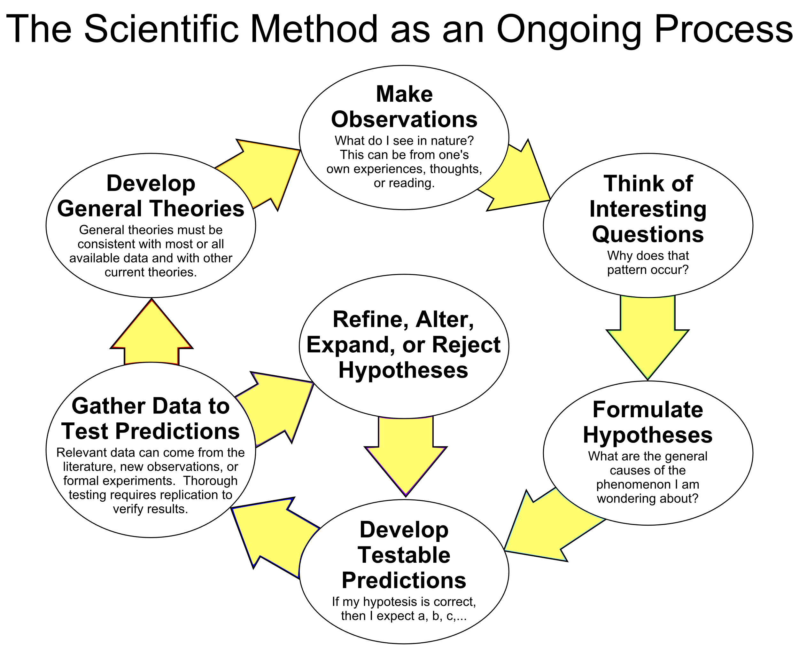
The Scientific Method
Scientists use the ___________________ to advance knowledge and understanding of how the natural world works.
  The key takeaway is that it is a logical process to solving a problem or answer a question.

Slide 4

One Approach to the Scientific Method
Steps of the Scientific Method
Make an observation
Pose a question
Form a hypothesis
Make a prediction
Design an experiment
Collect Data
Analyze Data
Draw a conclusion
Communicate Results
Notes:
Please note and explain to your students that they may see a much short or even longer version of the steps. It really just depends on how the authors “group” certain items together and what is left out to accommodate the appropriate level of science for the target student audience. You may ask the students what could be added or grouped together in the steps presented here? Maybe add repeat experiment?

Slide 5
Hypothesis
A ___________________ is a possible, testable answer to a scientific question or explanation of what scientists observe in nature.
Example Hypothesis: Grass growth is limited by the amount of available water.
  The thought process that may have occurred prior to this hypothesis:
    ___________________ - Hmmm…I have only had to cut the grass once in ten days.
    Question- Why is my grass not growing as fast?
    Hypothesis (see above example)-Notice the hypothesis is a testable explanation or answer to the question.
Notes:
The hypothesis is quite possibly one of the most confused terms presented to students. It is widely taught as an “educated guess” but is more frequently defined as more of an explanation. This is a great article written by Paul Strode on this topic. http://datanuggets.org/wp-content/uploads/2014/03/Strode-2015-Hypothesis.pdf

Slide 6
After the hypothesis
Using the same scenario as the previous slide…
___________________ - If the grass is given more water then it will grow faster.
___________________ - Scientist will set up a controlled experiment testing only ONE variable everything else must be kept constant (same)
Notes:
You may notice the prediction is written as an “if-then” statement. It is widely acceptable to write a hypothesis as an “if-then” statement however it does not meet the requirements of the definition of hypothesis we are using here (and in most books). If you wish to use in an “if-then” statement it is best to make it an “if-then-because” statement. The “because” portion of the statement is the explanation or answer to the testable hypothesis. This is a good spot to stop and ask students to take 5 minutes and describe how that would set up the experiment described.

Slide 7
Experimental Design Key Terms
___________________ -the variable that is being manipulated by the experimenter. It is the one thing that is changed in an experiment.
___________________ the variable that is being measured to determine the effect of the independent variable.
___________________ -the standard for comparison or normal.
___________________ - factors that are kept the same between the control group and experimental group.
___________________ -The group that is receiving the independent variable.

Slide 8


Other Scientific Terms to Know
___________________ is information that is collected to test the hypothesis.
  Quantitative data- A quantity or number that can be measured directly with a tool. (example-the number of centimeters the grass grew)
  Qualitative data- data describes qualities or characteristics.
A ___________________ is a physical or mathematical representation of a structure or system.
  Models are often necessary to display data in a way that is easier to interpret.

Slide 9

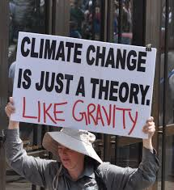
Scientific Theory
The term “___________________ ” is often used in everyday life to as a synonym for a hunch or a prediction but in science, it is much different.
In science the term theory is ___________________ and widely accepted hypothesis (explanation) or group of hypotheses.
  It is based on a large body of evidence often from multiple disciplines.
  Examples: Cell theory, plate tectonics theory, and climate change theory
Notes:
In this picture gravity is mentioned to be a theory. The actual theory being referenced here is the Newtons Theory of General Relativity that describes why things fall.

Slide 10

Advances in Human Knowledge
It is important to understand that theories, though well supported can change over time as technology develops and better explanations are discovered.
Part of the scientific process is peer reviewing.
A ___________________ involves scientists publishing the details of the methods they used, the results of the experiment, and their reasoning for their interpretations.

Slide 11
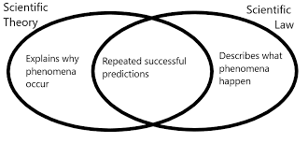
Scientific Law
___________________ is a well-tested and widely accepted description of observations that have been repeated many times in a variety of conditions.
  Example- Newton’s Law of Universal Gravitation or Mendel’s Law of Independent Assortment
Scientific laws describe observations but not how or why they occur, that is what theories are for.
Notes:
Newton's Law of Universal Gravitation tells us WHAT things do:
"Every point mass attracts every single point mass by a force pointing along the line intersecting both points. The force is directly proportional to the product of the two masses and inversely proportional to the square of the distance between the point masses.“
There is often confusion around this since “gravity” appears on slides as both a law and a theory. This situation offers a great opportunity to help students separate the terms theory (why it happens) and law (what happens).

Slide 12
Limitations of Science
Scientific research does not aim to “prove” anything absolutely.
  For example, we cannot prove or accurately measure how many tons of topsoil are eroded away each year. However, we can use tools, gather data, and apply statistics to get a logical estimate.
___________________ are humans. Humans are not free of bias about their own results and hypotheses though good scientists recognize their biases and try to avoid them.
Our data is only as good as the ___________________ we use to measure.

Slide 13



Bell Ringer: Where does a tree get its mass from?

Slide 14
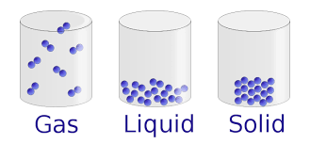
What is matter?
In order to understand many aspects of environmental science we must understand the basics of chemistry and energy.
___________________ is anything that has mass and takes up space. It can be in three common states –solid, liquid, or gas.
Matter can be an element, or it can be a compound.

Slide 15
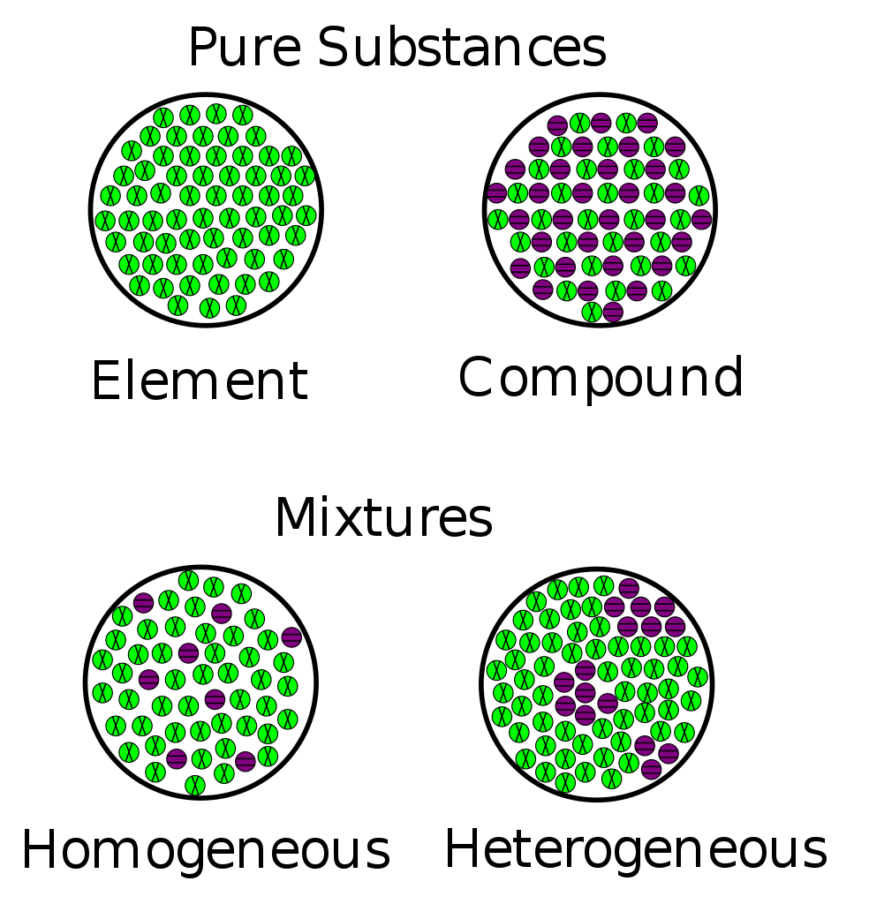
Element vs Compound
An ___________________ is a type of matter with a unique set of properties that cannot be broken down into simpler substances by chemical means.
  Example- C (Carbon), Ca (calcium), O (oxygen)
___________________ - A compound is two or more different elements held together in fixed proportions.
  Example: Water (H₂0), Glucose (C₆H₁₂O₆)

Slide 16

Atoms
An ___________________ is the basic building block of matter.
Atoms are composed of 3 subatomic particles:
  ___________________ -particles with no charge that are located at the center (nucleus) of the atom
  ___________________ -particles with a positive (+) charge located in the nucleus of the atom.
  ___________________ -smaller particles with a negative (-) charge in rapid motion outside the nucleus.

Slide 17
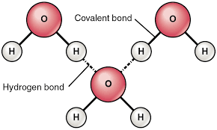
Molecules
___________________ are combinations of two or more atoms of the same or different elements.
  Example: Water (H₂0), Glucose (C₆H₁₂O₆) ← you may have noticed these are also examples of compounds
  Example: Oxygen (O₂) ← Oxygen is a molecule but not a compound.
___________________ are atoms or groups of atoms with a charge (+ or-)
  Example- Na⁺, Cl⁻

Slide 18
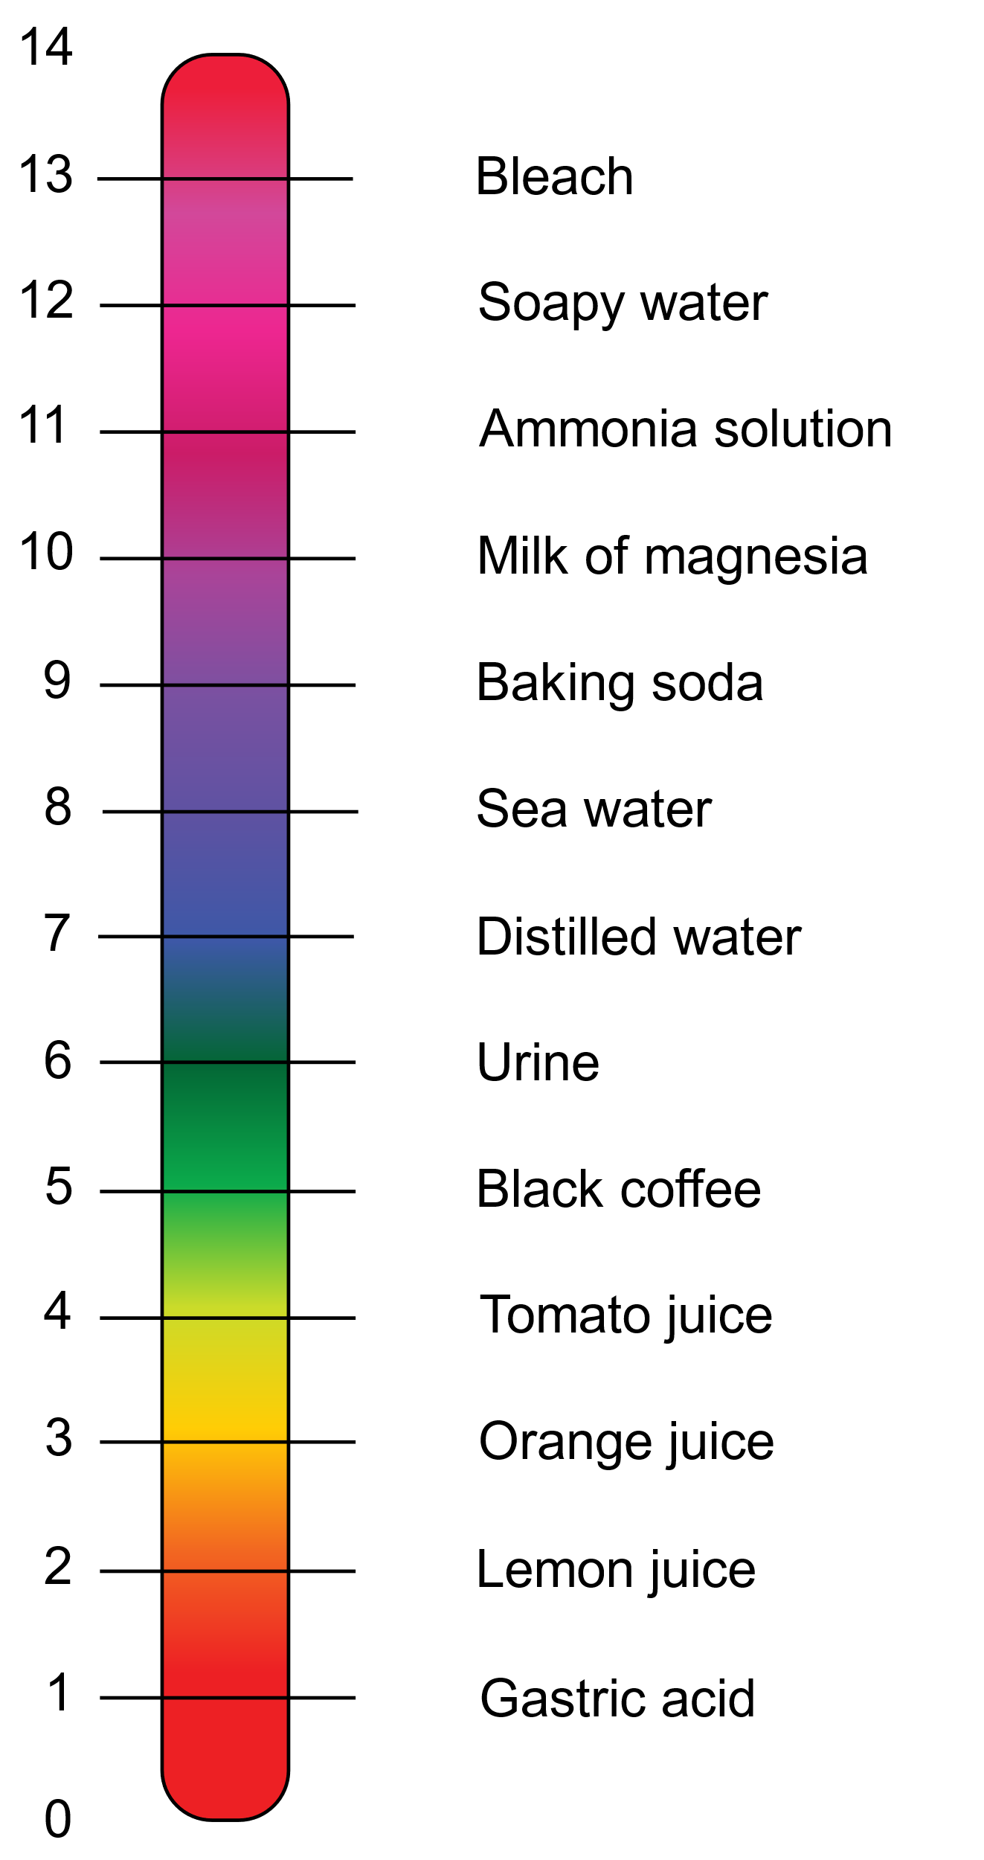
pH
The extra H+ combines with water to create Hydronium H₃O+
_______ is how acidic or basic something is based on how many ions of hydrogen (H⁺) or ___________________ (OH⁻) are present.
If a solution has more hydroxide ions (OH⁻) it is a basic or alkaline solution. (pH greater than 7)
If a solution has more hydrogen ions (H⁺) it is an acidic solution. (pH less than 7)
If the concentration of the (H⁺) and (OH⁻) are equal then the solution is neutral (pH 7)

Slide 19

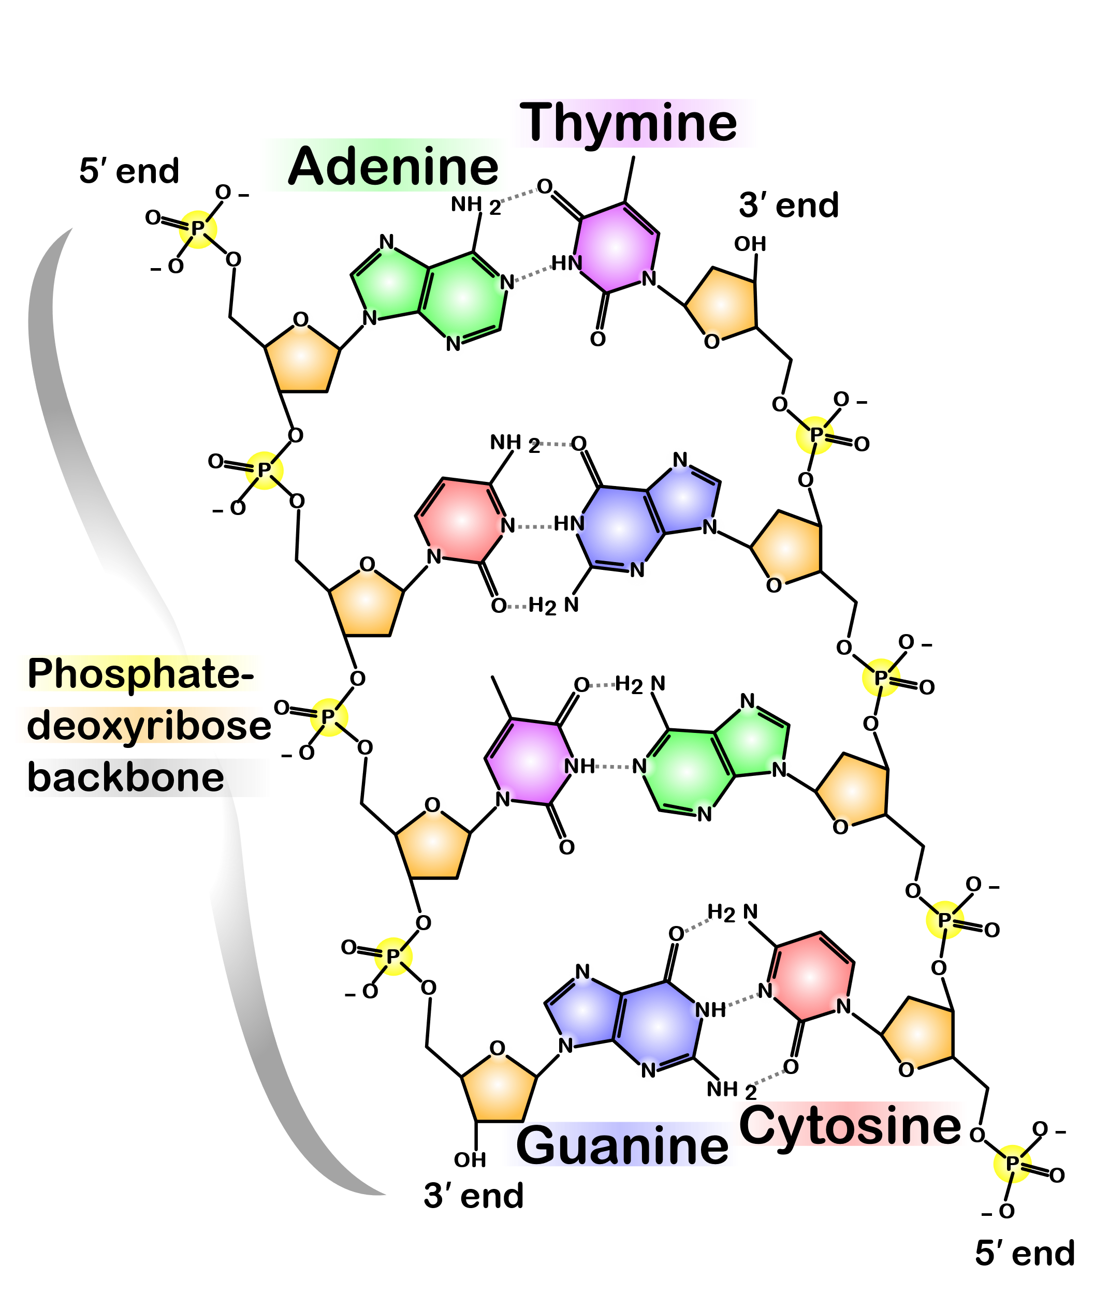
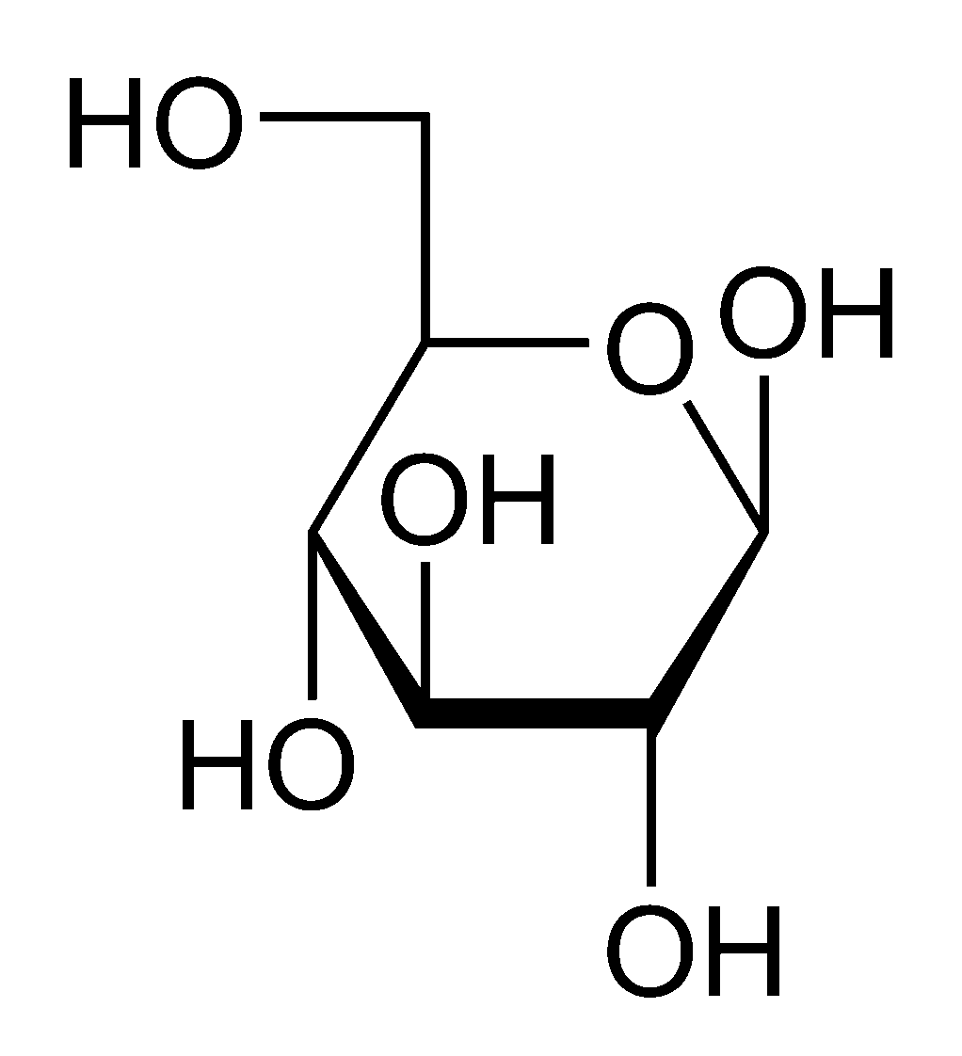
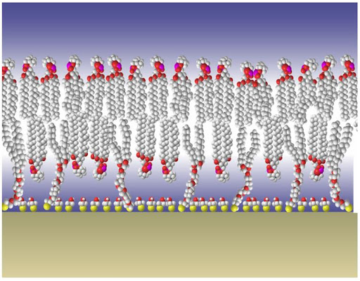
Molecules of Life
___________________ are compounds that contain at least two carbon atoms and one or more other elements. Most chemicals in your body are organic
  Example- Glucose (C₆H₁₂O₆)
  Exception- CH₄
The 4 Organic Molecules (Macromolecules)
    ___________________ -made of amino acids (Enzymes, muscles)
    ___________________ -made of fatty acids. Consists of fats, waxes, and oils.
    ___________________ - made of monosaccharides (single sugars)
    ___________________ -made of nucleotides (DNA, RNA)
    You will learn or did learn about these more in Biology.

Slide 20


Matter Can Change
___________________ can undergo either chemical or physical changes.
In a ___________________ there is no change in the composition of the substance.
  For example- Ice melting and becoming water, cutting a piece of metal in half.

Slide 21

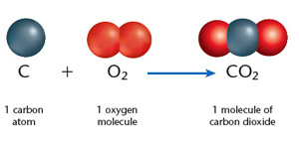
Chemical Change
In a ___________________ there is a change in the composition of the substance.
Chemists use chemical equations to represent these changes.
For example, the burning of coal which is mostly carbon (C) is combined with O₂ from the atmosphere to produce carbon dioxide (CO₂).
+ energy (heat)

Slide 22
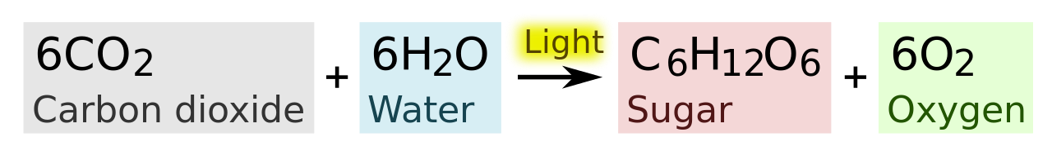
Law of Conservation of Matter
___________________ states that whenever matter undergoes a physical or chemical change, no atoms are created or destroyed.
Looking at a balanced chemical equation you can keep track of the changes and even the atoms.

Slide 23
Ball Observations
How high does the basketball bounce?
How high does the tennis ball bounce?
Prediction
What do you think will happen when they are dropped together (tennis ball on top of the basketball)? Will the distance each ball bounces be the same? Why? Why not?
Notes:
The basketball should not bounce as high is it did by itself, but the tennis ball should bounce higher since some of the kinetic energy is transferred from the basketball to the tennis ball.

Slide 24


Energy
___________________ comes in many forms. Energy is the capacity to do work.
As you may recall, understanding how to secure a source(s) of renewable energy is critical to allowing us to become a ___________________.

Slide 25
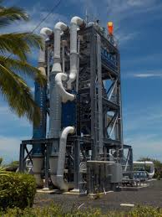
Types of Energy
Ocean thermal energy plant
___________________ is the energy associated with motion.
  Examples- a moving car, flowing electrons (electricity), and wind.
___________________ is also a type of kinetic energy. The hotter an object is the faster the molecules, atoms or ions are moving
Temperature is the measure of the average heat or thermal energy of a sample of matter.
Electromagnetic Radiation is another form of kinetic energy where the energy travels as a wave.
Notes:
Ocean Thermal Energy Conversion (OTEC) is a marine renewable energy technology that harnesses the solar energy absorbed by the oceans to generate electric power.

Slide 26
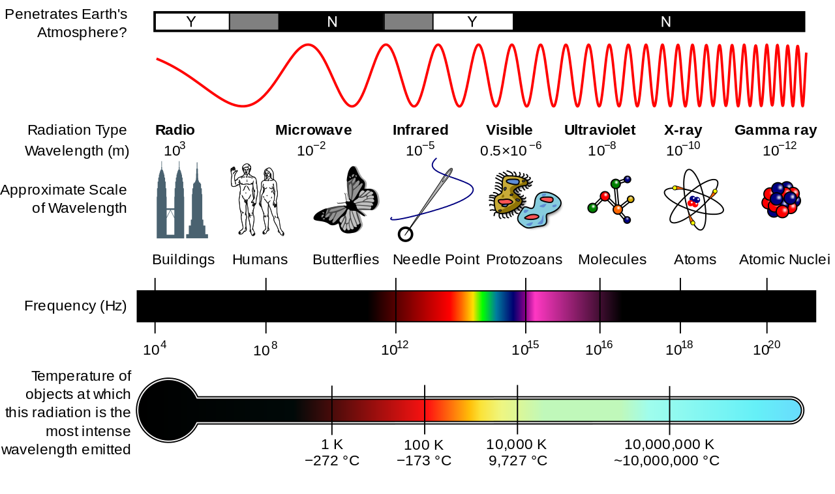
Kinetic Energy Continued
______________________________iis another form of kinetic energy where the energy travels as a wave. Different wavelengths have different amounts of energy.
The Sun emits electromagnetic radiation. This is the energy that fuels many of the processes on Earth.
Solar energy is a key factor in achieving sustainability.

Slide 27
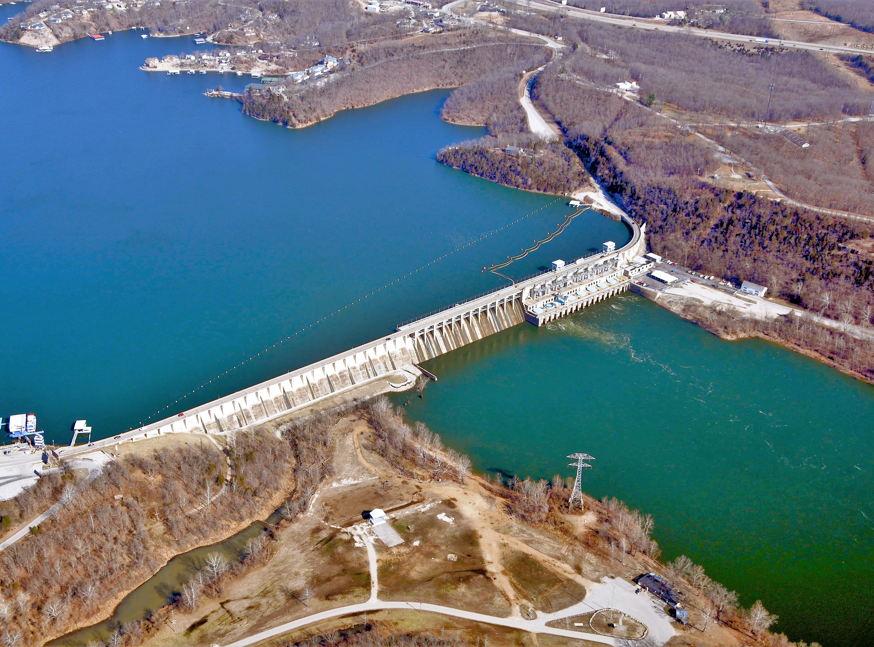
Potential Energy
___________________ is energy that is stored and potentially available for use.
Examples: A cell phone sitting on a desk. Energy is stored in the molecules of food and is released during digestion.
Potential energy can be ___________________ to kinetic energy. For example, water behind a dam can be used to power a turbine and convert the potential energy into kinetic energy.

Slide 28
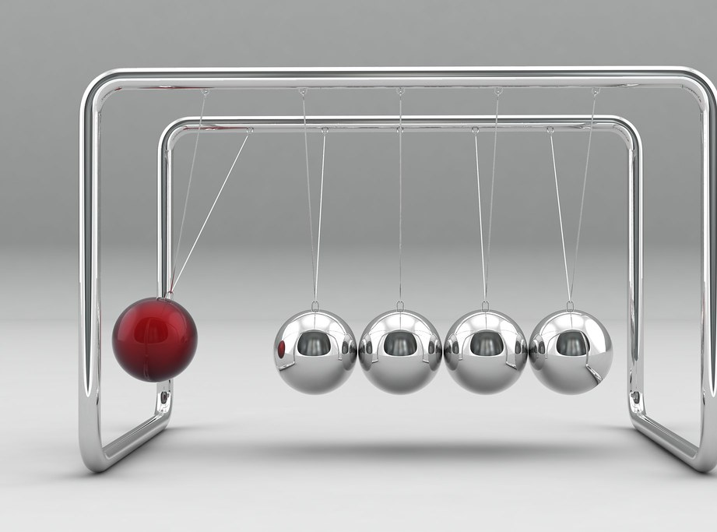
Energy Laws
____________________________________(Law of Conservation of Energy)- When energy is converted from one form to another in a physical or chemical change no energy is created or destroyed. The total amount of energy does not change.

Slide 29
Second Law of Thermodynamics
________________________________Whenever energy is converted from one type of energy to another type of energy in a physical or chemical change the resulting energy is lower-quality energy or less usable energy than before. This occurs because some energy is lost as heat.
This means that we cannot recycle high-quality energy.

Slide 30
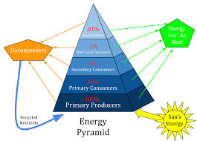
Systems
A ___________________ is a set of components that function and interact in some regular way.
Example- The human body, a forest, ecosystem and Earth.

Slide 31
Systems Continued
Systems have a few key components; ___________________ , ___________________ and ___________________.
For a system to be sustainable the throughputs must be able to handle the inputs and the environment must be able to absorb the outputs.
Do you think our system is sustainable? What are some examples of each component?
Inputs
(from the Environment)
Throughputs (system processes)
Outputs
(to the environment)

Slide 32
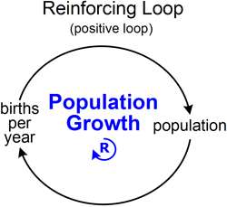
Feedback Loops
A ___________________ occurs when an output of matter, energy or information is fed back into the systems as an input and it can lead to changes in the system.
Positive Feedback Loop- Causes the systems to change in the same direction.
  Example- As vegetation in an ecosystem is lost more nutrients are washed away and as a result more vegetation is lost and even more nutrients are lost.
  When an ecosystem becomes locked into a feedback loop it can reach an ___________________ ___________________ where the ecosystem can experience a collapse.

Slide 33
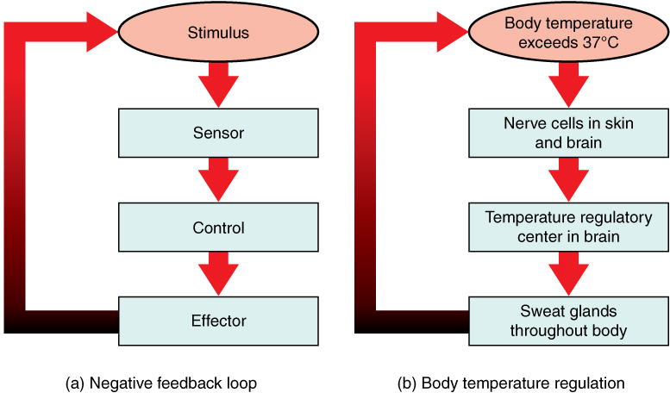
Negative Feedback Loop
A _______________________ causes the system to change in the opposite direction from which it is moving.
An example of a negative feedback loop is a thermostat in your home. When it gets too cold the heat turns on until it warms up again and then it stops. If it gets too hot the A/C will turn on until it is back to the set temperature.

