Slide 1
Heart Drawing
Learn the anatomy of the human heart!
Notes:
©Grey’s Digital Online, LLC
For more great resources visit: https://www.usbiologyteaching.com/

Slide 2
Supplies Needed
Paper or drawing app
Colors (blue, red, black)
Notes:
©Grey’s Digital Online, LLC
For more great resources visit: https://www.usbiologyteaching.com/

Slide 3
The Human Heart
Has Four Chambers
The average heart beats 115,000 times/day
The average heart is the size of an adult fist.
Your heart pumps about 2,000 gallons of blood every day.
An electrical system controls the rhythm of your heart. ..
Notes:
Fact Source:https://www.healthline.com/health/fun-facts-about-the-heart

Slide 4
The Human Heart
It’s possible to have a broken heart. It’s called broken heart syndrome and can have similar symptoms as a heart attack. The difference is that a heart attack is from heart disease and broken heart syndrome is caused by a rush of stress hormones from an emotional or physical stress event.
Death from a broken heart, or broken heart syndrome, is possible but extremely rare.
Notes:
Fact Source: https://www.healthline.com/health/fun-facts-about-the-heart

Slide 5
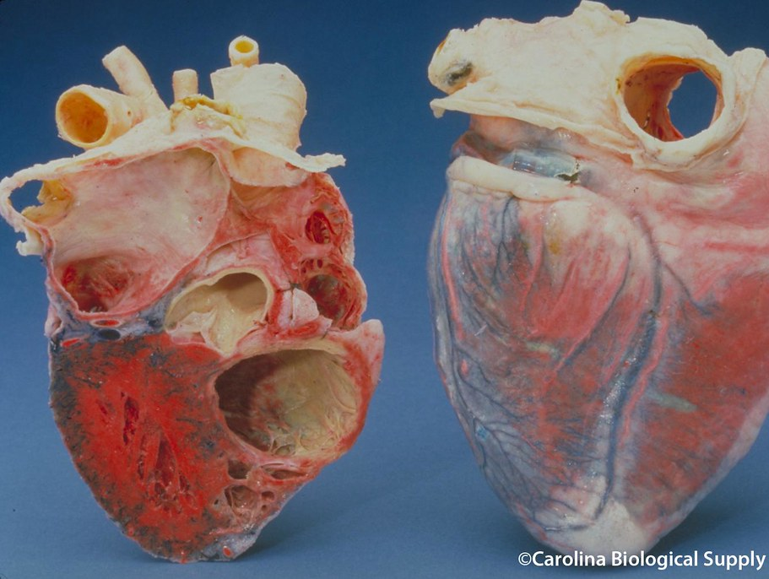
What does a real heart look like?
This Photo by Unknown Author is licensed under CC BY-NC-ND
This Photo by Unknown Author is licensed under CC BY-NC
Notes:
©Grey’s Digital Online, LLC
For more great resources visit: https://www.usbiologyteaching.com/

Slide 6
Objective
While drawing a heart, learn the basic parts of the heart and how blood circulates throughout the body.
Your drawing will be simplified so you do not need to be an artist to do this!
Notes:
©Grey’s Digital Online, LLC
For more great resources visit: https://www.usbiologyteaching.com/

Slide 7
Ready?
Like this!
Arrange your paper landscape
Notes:
©Grey’s Digital Online, LLC
For more great resources visit: https://www.usbiologyteaching.com/

Slide 8
Step 1: Note (Using a pencil is recommended since you may need to erase portions of your drawing). Draw a heart in the middle of your page.
Notes:
©Grey’s Digital Online, LLC
For more great resources visit: https://www.usbiologyteaching.com/

Slide 9
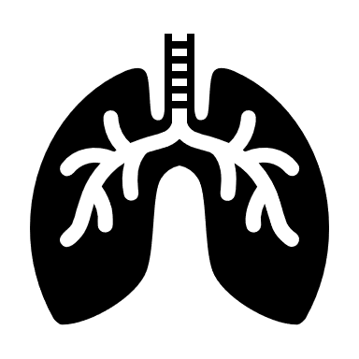
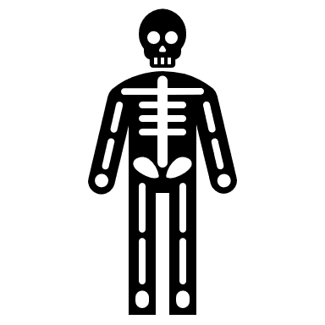
Step 2: To the left and right of the heart draw lungs and a body to represent pulmonary and systemic circulation.
Draw a square, circle or a stick figure if you want simplify your picture!
Draw a square or a circle if your want to simplify your picture!
Notes:
©Grey’s Digital Online, LLC
For more great resources visit: https://www.usbiologyteaching.com/

Slide 10
Step 3: Label the lungs pulmonary circulation and the body systemic circulation.
Pulmonary circulation
Systemic circulation
Notes:
©Grey’s Digital Online, LLC
For more great resources visit: https://www.usbiologyteaching.com/

Slide 11
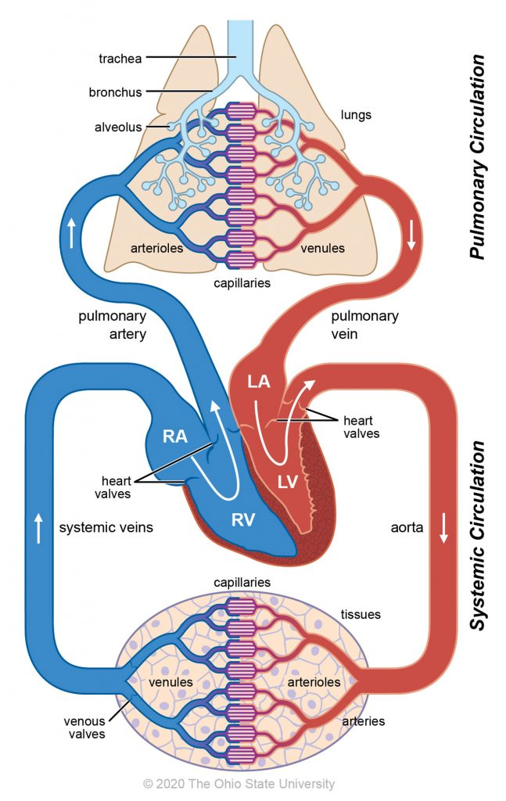
Circulation in the body
Systemic circulation pumps oxygenated blood to the body and returns deoxygenated blood back to the heart.
In pulmonary circulation, deoxygenated blood moves to the lungs to pick up oxygen (also releases CO₂) and returns to the heart where it can be then delivery throughout the body.
This Photo by Unknown Author is licensed under CC BY-NC
Notes:
©Grey’s Digital Online, LLC
For more great resources visit: https://www.usbiologyteaching.com/

Slide 12
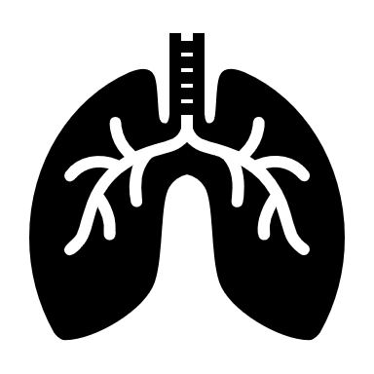
Step 4: Remember our heart has four chambers. Draw lines on your heart as shown to separate your heart into FOUR chambers. You can leave gaps as shown to leave room for some of the valves.
Pulmonary circulation
Systemic circulation

Slide 13
Step 5: Let’s add some labels. There are four chambers of the heart. The top two sections are the atria, and the bottom sections are the ventricles. When labeling someone else’s heart (or anatomical structure) it is labeled based on the patient’s perspective. In this case, the patient is looking at you. Label the left and right atrium and the left and right ventricle.
Pulmonary circulation
Systemic circulation
Right Side
(patient perspective)
Left Side
(patient perspective)
Notes:
©Grey’s Digital Online, LLC
For more great resources visit: https://www.usbiologyteaching.com/

Slide 14
Check your labels!
Right Atrium
Left Atrium
Pulmonary circulation
Systemic circulation
Right Ventricle
Left Ventricle
Notes:
©Grey’s Digital Online, LLC
For more great resources visit: https://www.usbiologyteaching.com/

Slide 15
Step 6: Draw tricuspid valve in the gap that is located in between the right atrium and ventricle. Label it.
Right Atrium
Left Atrium
Tricuspid valve
Pulmonary circulation
Systemic circulation
Right Ventricle
Left Ventricle
Notes:
©Grey’s Digital Online, LLC
For more great resources visit: https://www.usbiologyteaching.com/

Slide 16
Step 7: Draw the pulmonary artery as shown. Use blue to represent deoxygenated blood.
Right Atrium
Left Atrium
Tricuspid valve
Pulmonary circulation
Systemic circulation
Fun Fact: YOUR BLOOD IS NEVER BLUE! Deoxygenated blood is dark red which appears blue when looking through your skin.
Right Ventricle
Left Ventricle
Notes:
©Grey’s Digital Online, LLC
For more great resources visit: https://www.usbiologyteaching.com/

Slide 17
Step 8: Draw the pulmonary valve at the start of the pulmonary artery in the heart. Use blue to represent deoxygenated blood.
Right Atrium
Left Atrium
Tricuspid valve
Pulmonary circulation
Systemic circulation
Right Ventricle
Left Ventricle
Notes:
©Grey’s Digital Online, LLC
For more great resources visit: https://www.usbiologyteaching.com/

Slide 18
Step 8: Draw the pulmonary vein from the lungs to the left atrium. Use red and blue to show the oxygenation of the deoxygenated blood at the lungs. Then use red to represent the oxygenated blood going to the left atrium
Pulmonary vein
Right Atrium
Left Atrium
Tricuspid valve
Pulmonary circulation
Systemic circulation
Right Ventricle
Left Ventricle
Notes:
©Grey’s Digital Online, LLC
For more great resources visit: https://www.usbiologyteaching.com/

Slide 19
Step 9: Draw the mitral valve. The mitral valve connects the left atrium and the left ventricle.
Pulmonary vein
Right Atrium
Left Atrium
Pulmonary valve
Tricuspid valve
Mitral valve
(bicuspid)
Pulmonary circulation
Systemic circulation
Right Ventricle
Left Ventricle
Notes:
©Grey’s Digital Online, LLC
For more great resources visit: https://www.usbiologyteaching.com/

Slide 20
Step 10: Blood from the left ventricle moves out of the heart through the aorta . Draw the aorta from the upper left ventricle to the body.
Right Atrium
Left Atrium
Pulmonary valve
Mitral valve
Systemic circulation
Pulmonary circulation
Right Ventricle
Left Ventricle
Notes:
©Grey’s Digital Online, LLC
For more great resources visit: https://www.usbiologyteaching.com/

Slide 21
Step 11: Draw the aortic valve where the blood exits the heart into the aorta.
Right Atrium
Left Atrium
Pulmonary valve
Tricuspid valve
Aortic valve
Mitral valve
Systemic circulation
Pulmonary circulation
Right Ventricle
Left Ventricle
Notes:
©Grey’s Digital Online, LLC
For more great resources visit: https://www.usbiologyteaching.com/

Slide 22
Step 12: After the oxygen is used up, the blood must return to the heart to be pumped back to the lungs. Draw the vena cava (systemic veins) that return the blood from the body to the right atrium.
Vena Cava (superior and inferior)
Right Atrium
Left Atrium
Pulmonary valve
Tricuspid valve
Aortic valve
Mitral valve
Systemic circulation
Pulmonary circulation
Right Ventricle
Left Ventricle

Slide 23
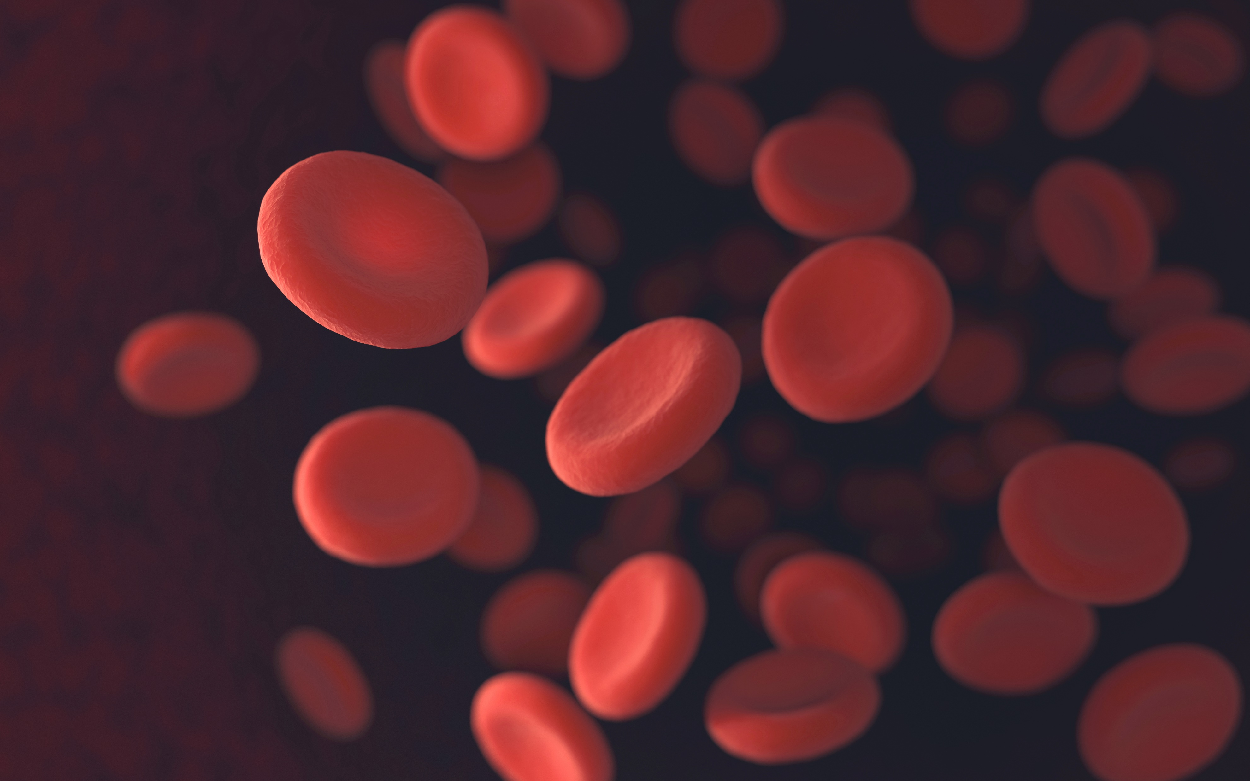
Step 13: Starting in the right atrium draw arrows showing the direction of the blood until you arrive back at the right atrium.
Vena Cava (superior and inferior)
Right Atrium
Left Atrium
Pulmonary valve
Tricuspid valve
Aortic valve
Mitral valve
Systemic circulation
Pulmonary circulation
Right Ventricle
Left Ventricle
Notes:
©Grey’s Digital Online, LLC
For more great resources visit: https://www.usbiologyteaching.com/

Slide 24
Step 13: Starting in the right atrium draw arrows showing the direction of the blood until you arrive back at the right atrium.
Vena Cava (superior and inferior)
Right Atrium
Left Atrium
Pulmonary valve
Tricuspid valve
Aortic valve
Mitral valve
Systemic circulation
Pulmonary circulation
Right Ventricle
Left Ventricle
Notes:
©Grey’s Digital Online, LLC
For more great resources visit: https://www.usbiologyteaching.com/

Slide 25
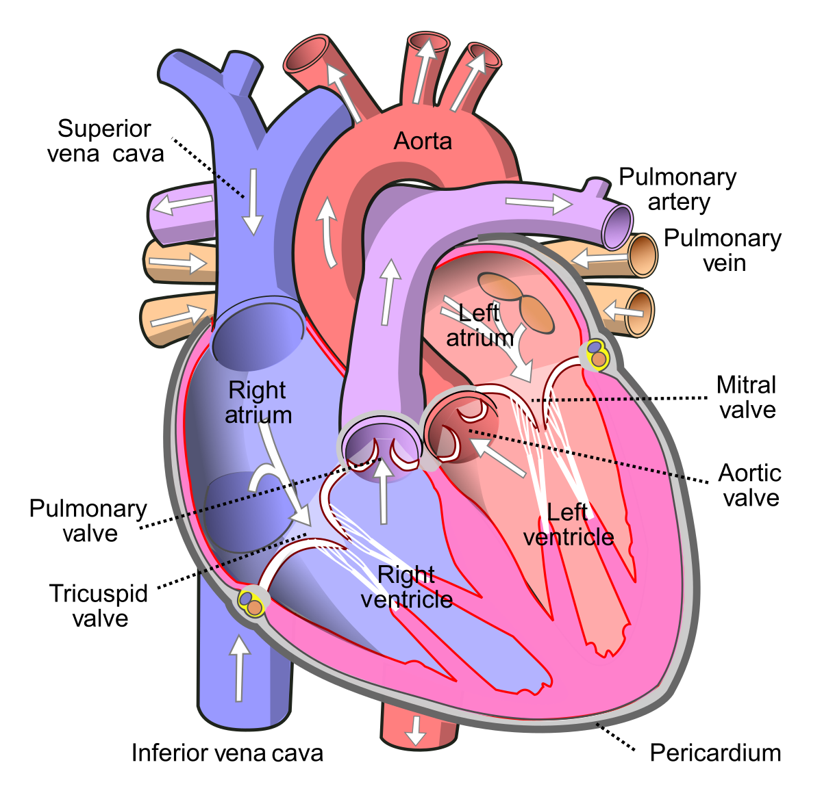
Lesson Extension: Compare your heart drawing to an actual heart.
What are some differences from our simplified drawing and the actual heart structures?
This Photo by Unknown Author is licensed under CC BY-SA
Notes:
Possible answers: The shape is different. The pulmonary veins do not show the heart pumping blood to both sides of the lungs. The aorta excludes the left subclavian artery, left common carotid and the brachiocephalic artery.

