Slide 1



Environmental Science
Lesson 1: introduction to ES and Sustainability
Notes:
Copyright Grey's Digital Online, LLC 2020-present (usbiologyteaching.com)

Slide 2
Welcome-Find your seat
On your desk you will find two index cards. Place your name (largely) on the front and back of one index card.
On the second index card (lined side) answer the following questions:
  What is your favorite thing to do outside of school?
  What is something you consider yourself good at?
  What is a possible career or job you think you might pursue after high school?
  What grade do you hope to achieve in this course?
  What will one thing can you do each do to ensure you achieve the grade you want?
  What concerns do you have about this course?
Notes:
Collect the index cards. The set with the names on it you can use to call on students in a fair, random way. It is also super helpful and quick to use them for lab groupings. You can “stack the deck” and strategically pick the lab groups and it seems completely random to the students. The other index cards are good to keep on file and review regularly as you build positive student relationships.

Slide 3

Welcome to Environmental Science
What does environmental science mean to you?
What does sustainability mean to you?
In what way do you think environmental science and sustainability are related?
What do you think/hope to learn in this course?

Slide 4
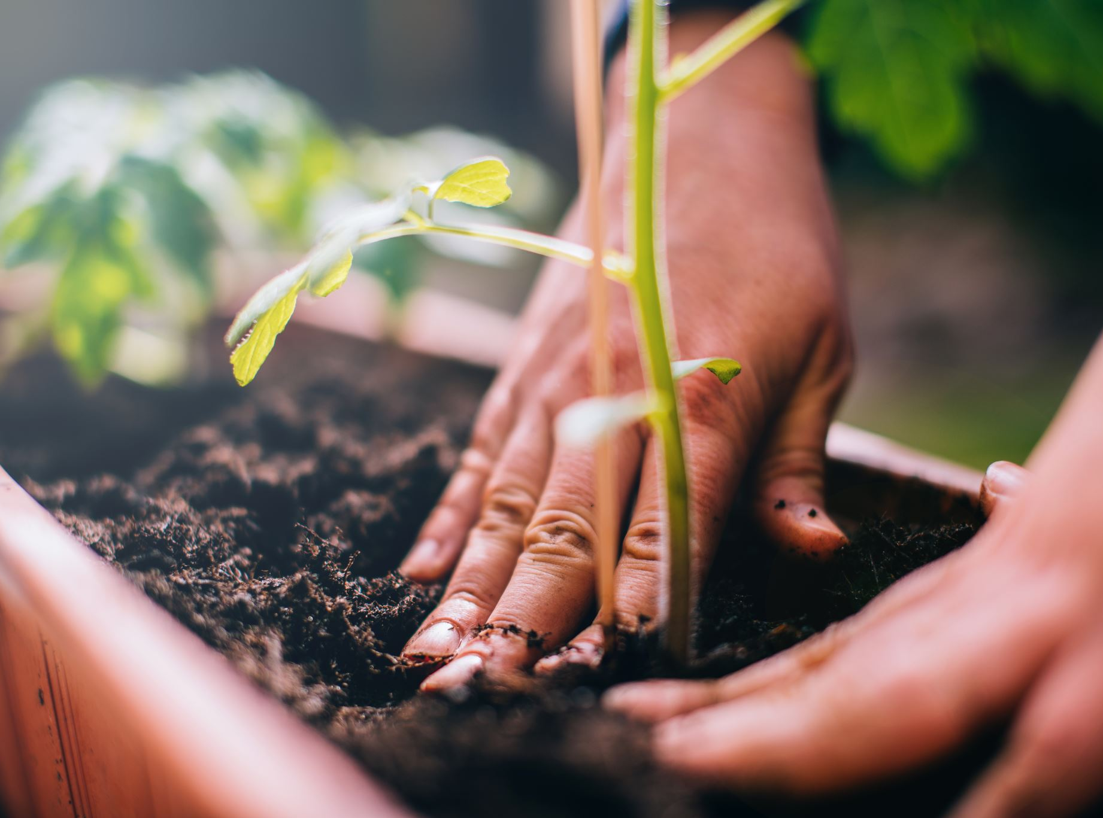
What is sustainability?
Sustainability is the capacity of the Earth’s natural systems to maintain stability of life (including human social factors) indefinitely.
“Sustainability means meeting the needs of the present without compromising the ability of future generations to meet their needs.”
There are 3 major scientific factors that contribute to long term sustainability:
  Solar Energy
  Biodiversity
  Nutrient Cycling

Slide 5

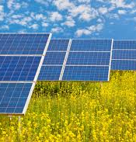
Solar Energy
The Sun provides energy for photosynthetic organisms to make food which in turn provides energy for all living things.
The Sun’s energy indirectly powers:
  Winds → wind generated electricity
  The Water Cycle→ hydroelectric energy

Slide 6
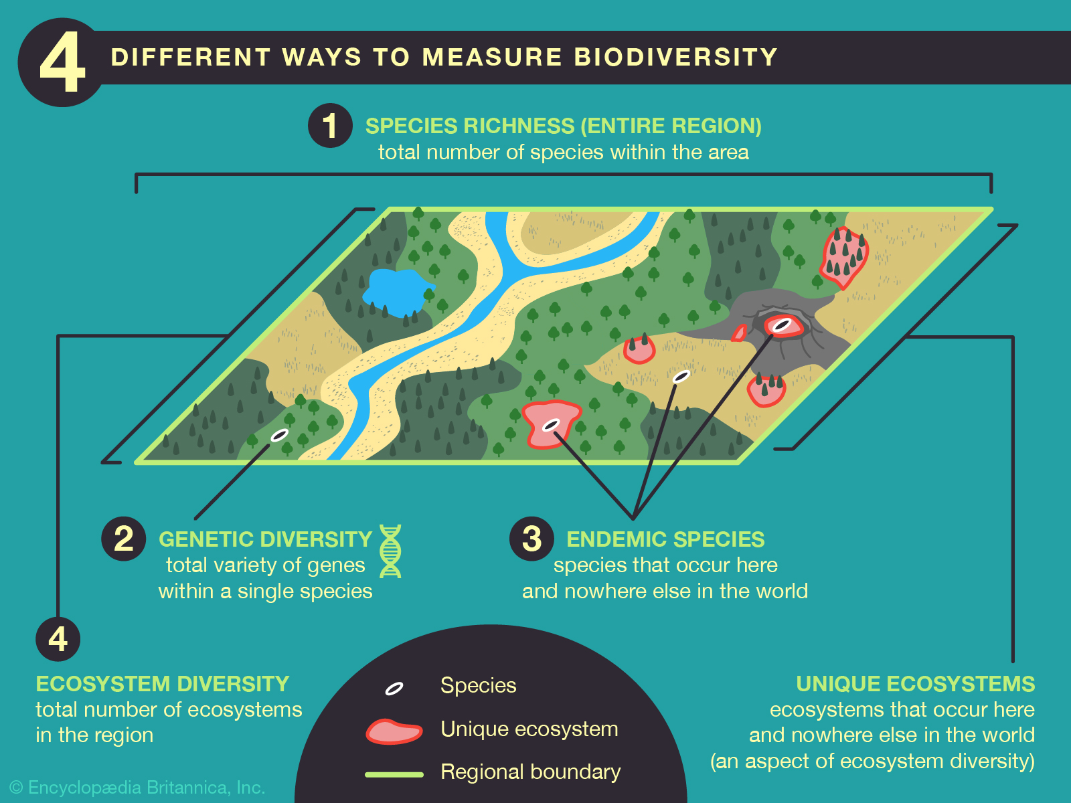
Biodiversity
Biodiversity consists of the variety in forms of species, genes, ecosystems and environmental interactions.
Biodiversity provides a way for organisms to adapt (evolve) to the ever- changing environment.

Slide 7

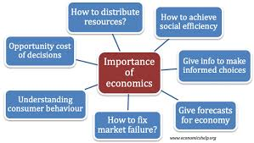

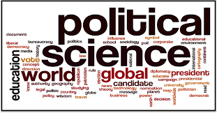
Human Social Factors of Sustainability
There are 3 Major Factors that influence our ability to become a sustainable:
Economic
Political science
Ethics

Slide 8

Economics and Sustainability
Economics is a social science that is concerned with the production and consumption of goods and services in the creation/transfer of wealth.
Why do you think we should care about economics in environmental science class?
(discussion)
Notes:
The next slide reveals the main reason we care about economics in ES.

Slide 9
Economics and Sustainability
We should care because….
The creation of some products can damage the environment.
Some economist encourage companies to include environmental costs of making their product into the market price.
  Profit can then be used to mitigate the environmental damage.
  This practice is call “full-cost pricing”
    What challenge may this cause for a company?
Notes:
Answer to question: This will cause their product to be priced higher. Competitors who do not have a concern for the environment could offer the product at a lower price.

Slide 10
Political Science
Political science is the study of systems of government and analysis of political behaviors.
Why do we care about political science in environmental science?
(discussion)

Slide 11
Political Science
We should care because political action leads to:
New laws that can protect the environment
Allocation of funding to environmental or sustainability causes
Collaboration across the globe on environmental issues

Slide 12
Ethics
Ethics is a branch of philosophy and the systematic study of right and wrong actions.
Why do we care about ethics in environmental science?

Slide 13
Ethics
Right and wrong can often be difficult to determine when many perspectives are considered.
Sometimes when making decisions about protecting species or the environment the livelihood of other individuals could be at stake.
  Example: Your family owns a fishing company and you are suddenly told you cannot fish for the species that has supported your family for generations because it is now protected. How would you feel?
Ethicists argue that society should leave the planet good or better condition they found it.

Slide 14
Sustainability and Natural Capital
Natural capital -consists of the natural resources and the ecosystem services that keep humans and other organisms alive and support human economies.
Natural Resources- are the materials and energy sources in nature that are essential or useful to humans.
Examples: water, trees, petroleum, minerals, plants
Natural resources fall into one of three categories: inexhaustible, renewable and non-renewable.

Slide 15

Natural Resources
Inexhaustible resources-a continuous resources that does not run out.
  Example: The Sun (for at around another 6 billion years)→ results in wind and flowing water that can produce electricity.
Renewable Resource- A resource that can be replenished by natural processes faster than it is used.
  Can be forests, wildlife, grasslands, fertile topsoil, clean air
Nonrenewable Resources- Exist in a fixed amount or it takes million or billions of years to make.
  Example: Fossil fuels (coal, oil, natural gas), mineral resources (copper, salt)

Slide 16
Economic Services
Economic Services are natural services provided by the ecosystem that support life and human economies at no monetary cost.
Examples:
Nutrient cycling
Air/water purification
Pest control
Topsoil renewal
Pollination

Slide 17
Review Questions
What are three scientific factors of sustainability?
What are three social factors of sustainability?
What factor(s) do you think will be most critical as we strive for a sustainable planet? Be prepared to defend your perspective.
Notes:
Solar energy, biodiversity and nutrient cycling
Economics, Political Science, Ethics

Slide 18
The Good News
People can work together to make a difference
Creative thinking, scientific research, political pressure by citizens and regulatory laws have improved the quality of life for many people on Earth….especially in developed countries.

Slide 19
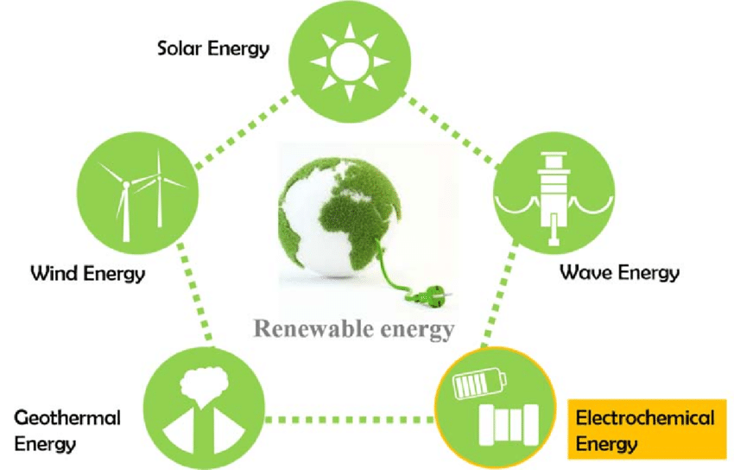
More Good News
We have learned how to harness amazing amounts of sustainable energy from the sun, wind, geothermal energy and nuclear energy.
We can manipulate our environment and live in comfortable buildings.
What are some ways humans have improved their quality of life over time?

Slide 20

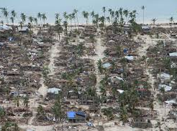
The Bad News-Unsustainable Living
People are living unsustainably.
People continually deplete and waste the Earth’s natural capital this is known as environmental degradation.
People do not always realize they are participants in environmental degradation, but we all are to some extent.
Why do you think environmental degradation occurs? In what ways do you participate?
Notes:
Always remember when asking questions to allow appropriate wait time for students to develop their thoughts. A good technique is to pause and give them 1-4 minutes to write out their thoughts. Discourage students from yelling out answers. Other students will eventually shut down if certain students always yell out a correct answer before they can even process the question.

Slide 21
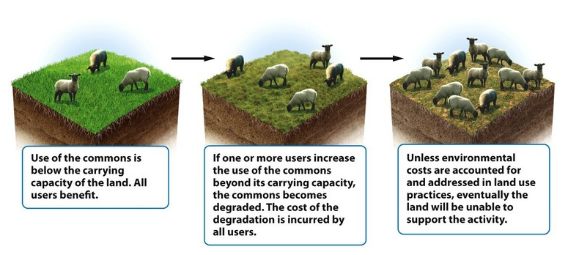
Why do humans behave in this manner?
Biologist Garret Hardin (1915-2003)- the “Tragedy of the Commons”
The conflict between the short-term interests of individuals and the long-term welfare of society.
The idea that “the little bit that I use or pollute won’t make a difference.”
“Commons” is a shared resource. Global commons include oceans, air and habitable earth
Notes:
Hardin observed that when land was held in common, individuals tended to graze as many animals as possible. Overgrazing led to the destruction of the land resources (environmental degradation). When commons were replaced by enclosed fields owned by individuals, people tended to graze only the number of animals that the land could support.

Slide 22
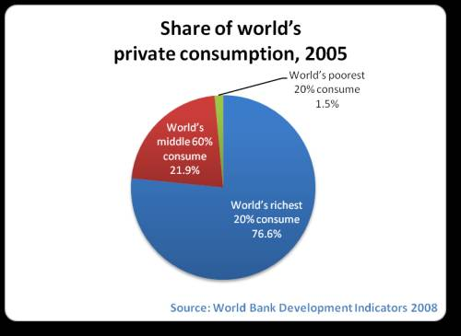
What is the result of this behavior?
60% of the Earth’s ecosystem services are being overused and most of the degradation has occurred since 1950.
Since countries differ in their available resources, they also differ in how they are used.
The more resources that are available to individuals or countries, the more the tend to consume.
The less available resources, the less individuals or countries consume.
Notes:
Source: https://www.millenniumassessment.org/en/index.html

Slide 23
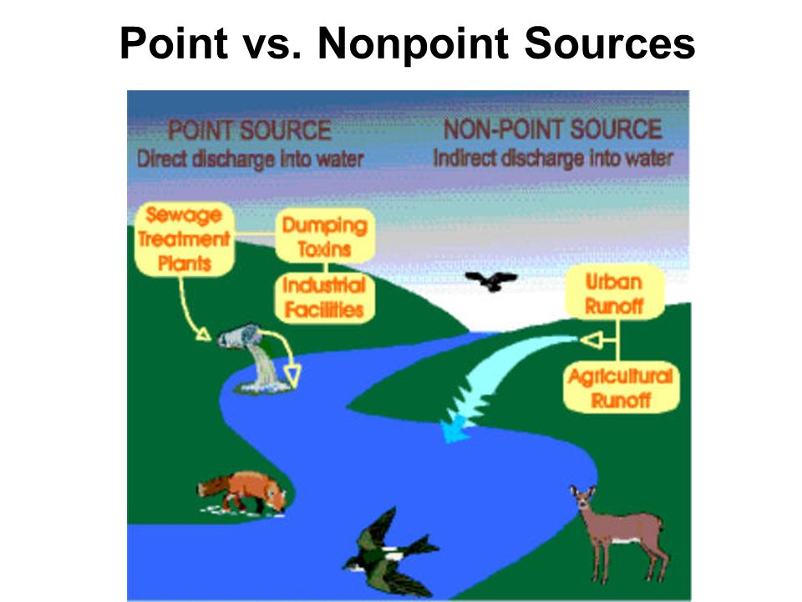
Tragedy of Commons-Pollution
Pollution is the contamination of the environment by any chemical or agent, such as noise or thermal levels considered to be harmful to living organisms.
Types of Pollution
Point Source- any identifiable source of pollution from which a pollutant is discharged.
  Smokestack, chimney, oil spill
Non-Point Source- consists of pollutants that come from many diffuse sources and are hard to pinpoint.
  Run off, residential areas, construction sites, highways and etc..

Slide 24
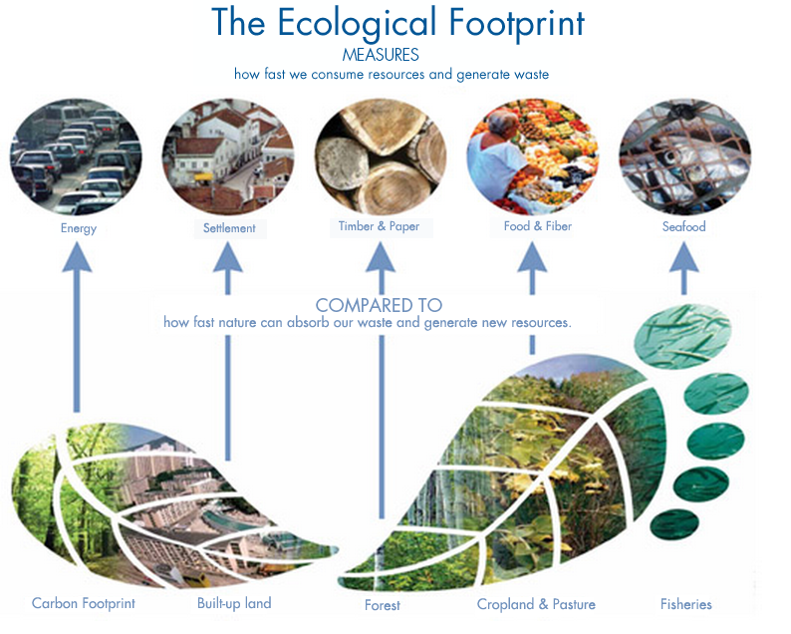
How Big Is Your Ecological Footprint?
Ecological footprint is the amount of land and water needed to supply an individual or population with renewable resources and to absorb and recycle the wastes and pollution produced.
The size of the footprint is typically proportional to the amount of resources consumed.
Which countries do you think have the highest ecological footprint?

Slide 25
Ecological Footprints by Country/Region
World-2.75 gha/person
Top 5 Largest Footprint (gha/person) as of 2020
Luxembourg-15.82
Aruba-11.88
Qatar-10.8
Australia-9.31
United States-8.22
Bottom 5 Smallest Footprints (gha/person) as of 2020
Eritrea-.49
Timor-Leste-.48
Haiti-.61
Bangladesh-.72
Pakistan-.79
Notes:
gha=global hectare (gha) is a measurement unit for the ecological footprint of people or activities and the biocapacity of the earth or its regions. One global hectare is the world's annual amount of biological production for human use and human waste assimilation, per hectare of biologically productive land and fisheries.
Source: https://en.wikipedia.org/wiki/List_of_countries_by_ecological_footprint

Slide 26

What Causes Environmental Problems and Why Do the Persist?

Slide 27
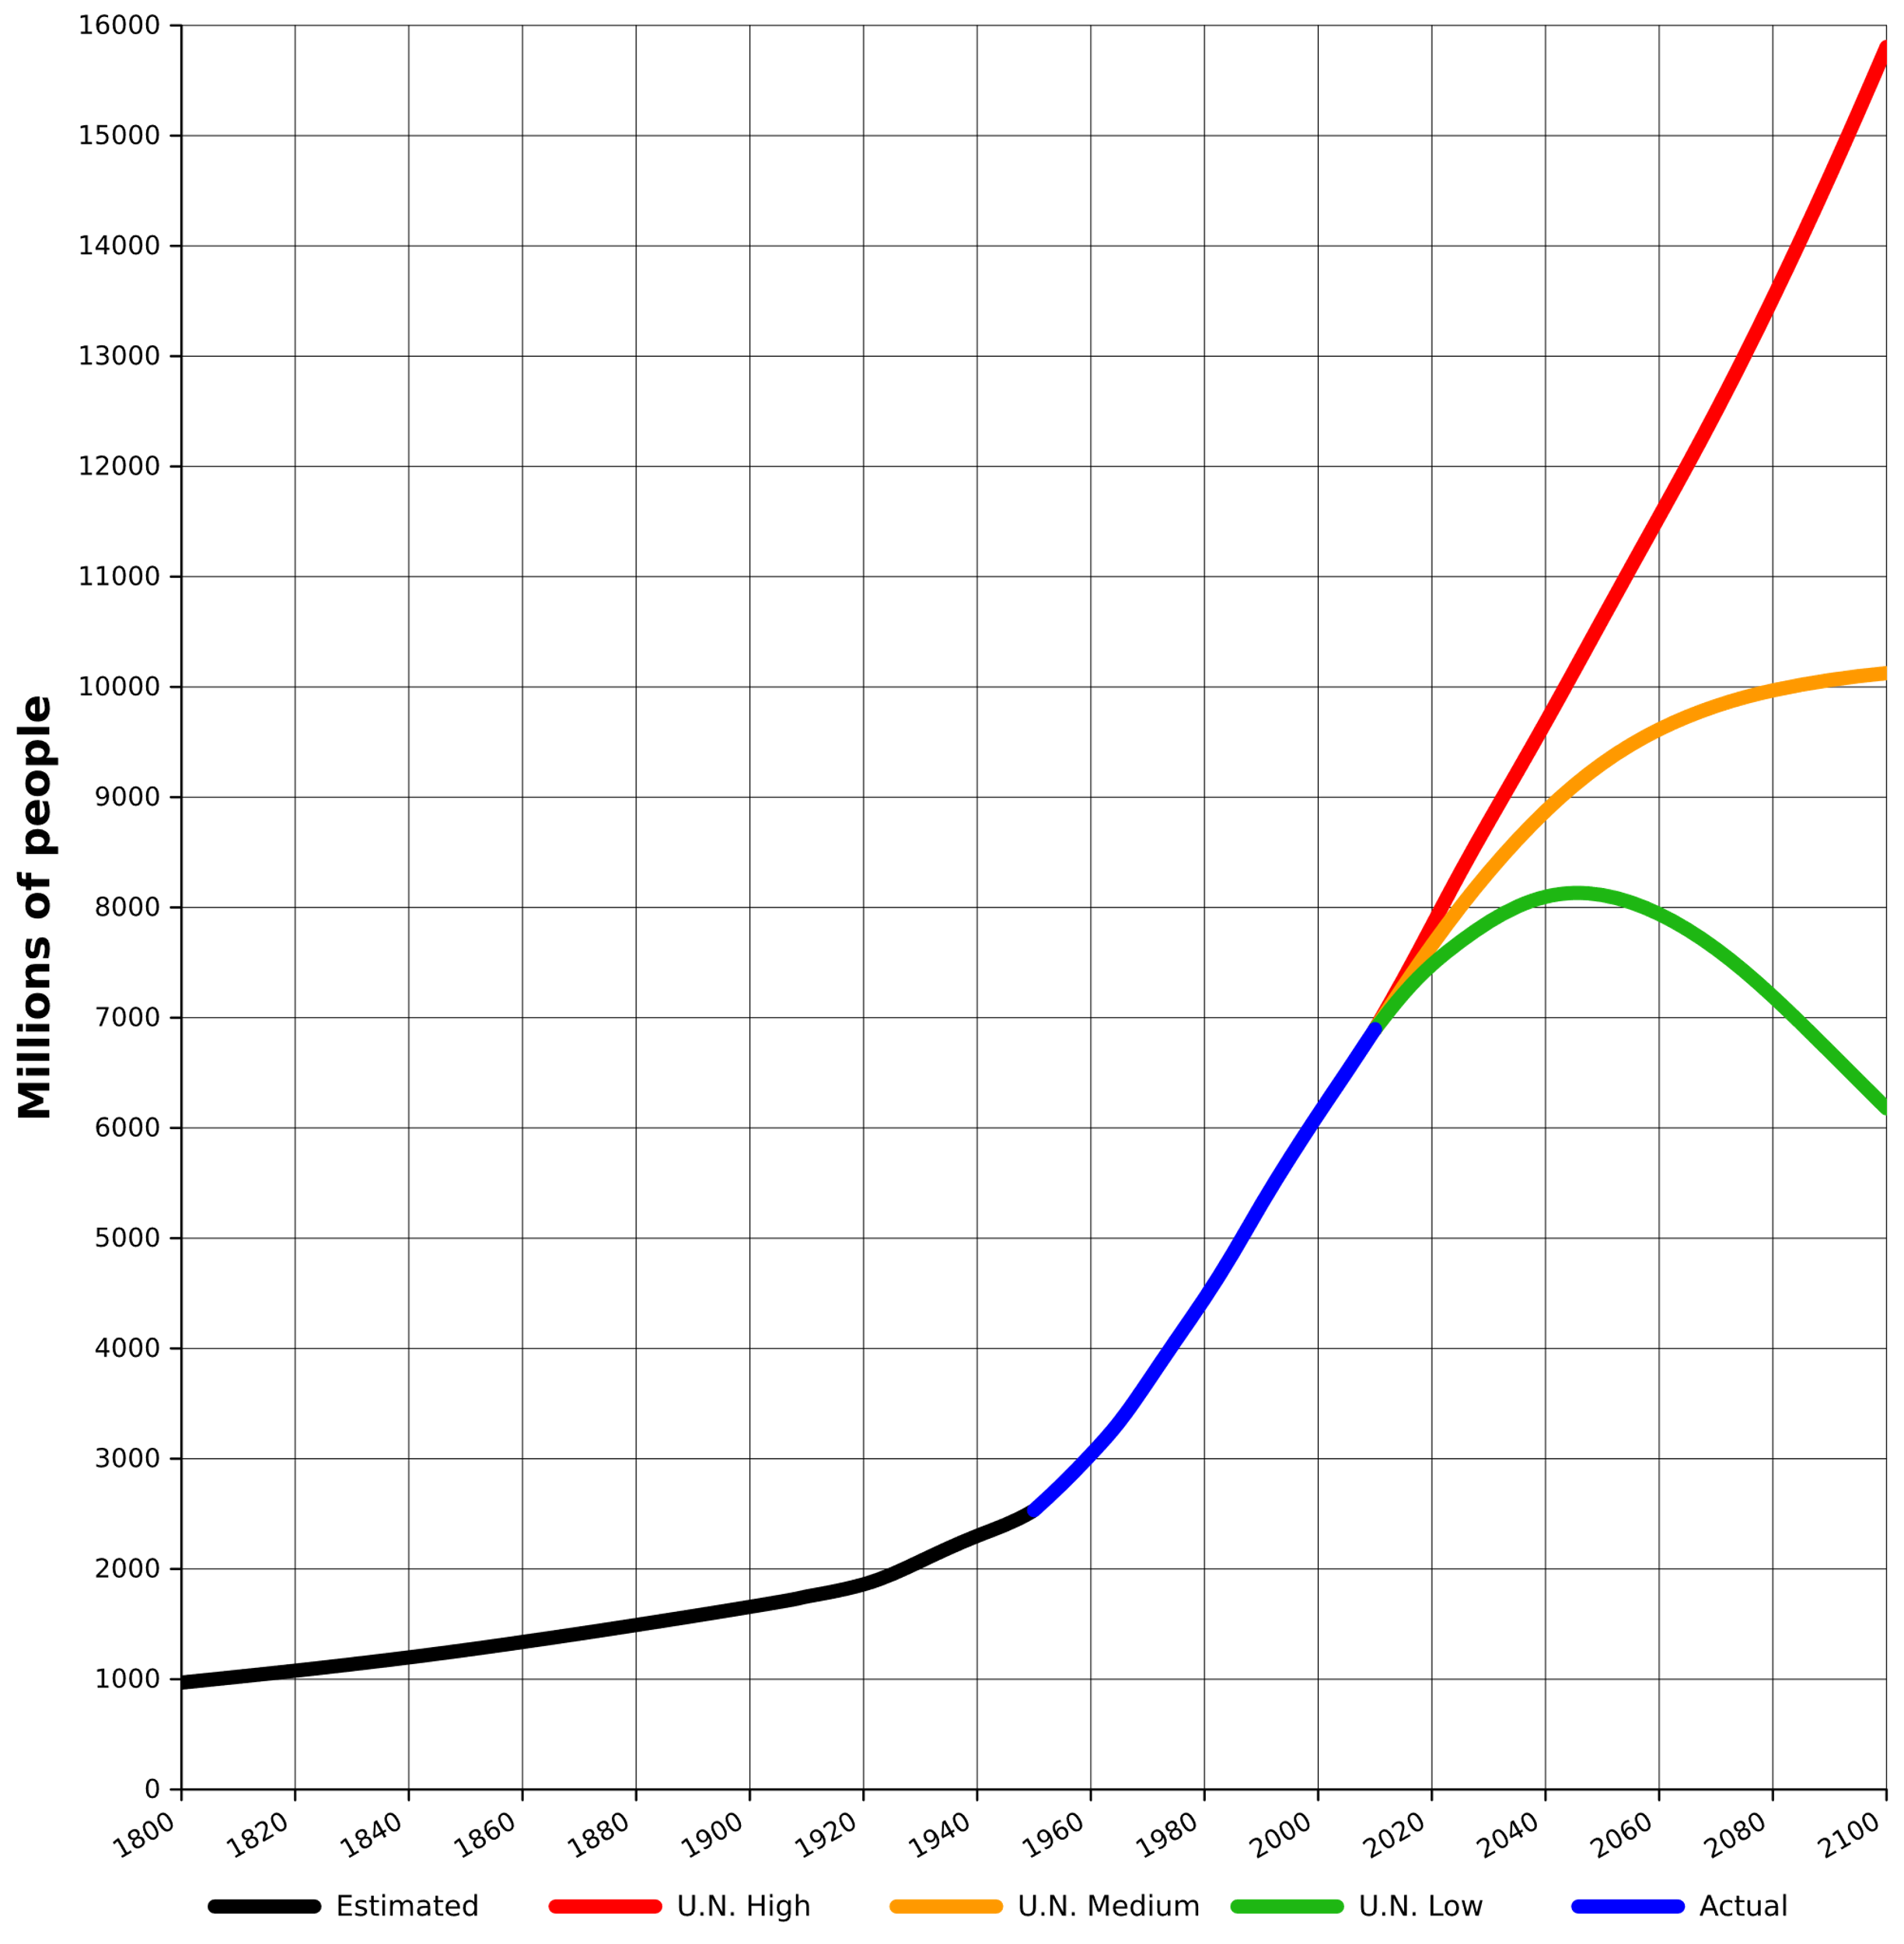
Human Population Growth
Human Population Growth Rate Predictions
Exponential Growth
Most scientists agree that major causes for environmental problems is human population growth.
Exponential growth occurs when a quantity increases at a fixed percentage per unit of time for example the current human populations growth rate is 1.1% per year.
Logistical Growth

Slide 28
Affluence and Resource Use
The lifestyles of the growing population of consumers are built on growing affluence (wealth).
The wealthier an individual or populations is the more resources they consume. This is a problem with a growing population unless individuals make the choice to live more sustainably.
The World Wildlife Fund predicted in 2012 that if every person lived like an American that we would need five Earth’s to sustain the consumption.
By 2050, it is estimated we will need 3 Earth’s to be sustainable.
Notes:
Source: https://www.worldwildlife.org/publications/living-planet-report-2012-executive-summary

Slide 29
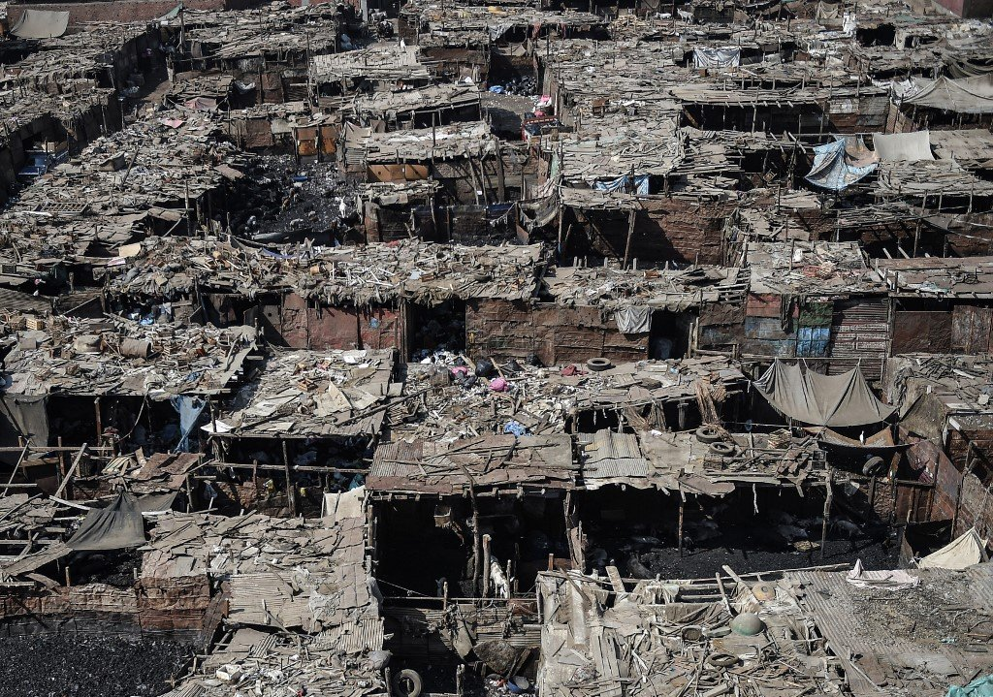
Poverties Impact on the Environment
Poverty is the condition where people do not have enough money to fulfill their basic needs for food, water, shelter, health care and education.
3 in 10 people on Earth live in poverty (~$3.10/day) or about 2.1 Billion people.
  Of the 2.1 Billion- 900 million live in extreme poverty (~$1.90/day)
  900 million is about 3 times the US population (~330million)
Notes:
Photo: Ezbet al-Nakhl, Egyptian capital Cairo.

Slide 30
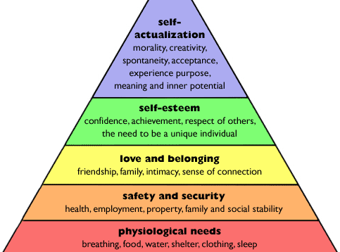
Impact of Poverty
People living in poverty focus on getting their daily needs met (food, water, fuel for heating water and the shelter)
As a result, the long-term environmental consequences are not a concern…survival is.
People in these situations may be forced to degrade their resources just to survive.
Notes:
Image: Maslow’ Hierarchy of Needs offers a great discussion point about why some people may be more concern with survival of themselves rather than the environment.

Slide 31
People are Becoming Increasingly Isolated from Nature
More than half of the world’s people live in Urban areas.
The increased use of electronic devices is isolating people from the natural world thus they are more likely to not have a personal connection to environmental issues.

Slide 32

People Have Different Perspectives About Environmental Issues
People’s opinions differ on the seriousness of environmental problems.
These difference occur because people have varying environmental worldviews.
  Environmental worldview is your set of assumptions and values concerning the natural world and what you think your role is in managing it.
  Environmental Ethics is the study of varying beliefs about what is right and wrong with how people treat the environment.

Slide 33


Types of Environmental Worldviews
Human Centered- sees the natural world as a support system for human life. Humans are separate from and in charge of nature and humans should mange the Earth in a way that is beneficial to humans.
Life Centered- all species have value in fulfilling their role within the biosphere regardless of their use or value to society. We have a responsibility to protect species.
Earth Centered- people are part of and dependent on nature. The Earth’s natural capital exists for all species, not just human.
What is your worldview?

Slide 34
Will we become environmentally sustainable society?
What will it take?
An environmentally sustainable society is a society that protects its natural capital and lives off its income.
A society that meets the needs now and for the future generations without compromising future generations ability to meet their basic needs.
Living sustainably mean living on natural income which is the proportion of natural resources that can be used sustainably.

