Slide 1

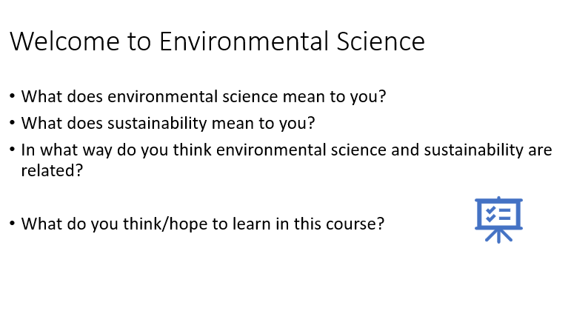
Date: First Day of School
Environmental Science
Bell Ringer:
Find your seat and complete the index cards.
HW: Sign and return the course syllabus and safety contract and all other school forms.
Schedule:
Introduce the course syllabus and expectations.
Complete Slide 3 questions in your guided notes –time permitting.
Objective:
Students will be able to describe the top 3-5 course/teacher expectations.
Notes:
The first day of school varies greatly. It is important to establish your procedures. On the schedule you will see item #2 on the schedule is the bell ringer for the first instructional day. If you have time start it and go over it with students. For day you can simply review slide 3 and discuss review procedures. I like to make a mini quiz on the procedures and go over it with the students. Since procedures are vastly different that is something not provided in the curriculum.

Slide 2
Date:
Environmental Science
Lesson Day 1
Bell Ringer: Review classroom procedures. Complete the questions from slide 3 in your guided notes.
HW: Reread your notes. Study the key terms on Quizlet. Complete the ecological footprint student worksheet it will be needed when we complete the Ecological Footprint Activity in a few days.
Schedule:
Complete slides 1-17 guided student notes.
Discuss various topics during the presentation. Be prepared to share your thoughts
Closing Activity: Closing discussion of the topics-Slide 17. Review Classroom procedures.
Objective(s):
Define sustainability and discuss the challenges of achieving it.
Upcoming Assessments:
Vocab Quiz: TBD
Test : TBD
Notes:
If you had time to complete slide 3 the previous day review the procedures on this day as part of the bell ringer. You may ask them describe 3 expectations that you have in the classroom on a piece of paper.

Slide 3
Date:
Environmental Science
Lesson Day 2
Bell Ringer: Complete 1.1 Sustainability Bell Ringer.
HW: Study Key Terms from slides 1-17, Review Notes. Complete the ecological footprint student worksheet it will be needed when we complete the Ecological Footprint Activity in a few days.
Schedule:
Sustainability Activity 1.1
Brainstorm terms that come to mind when you hear the word sustainability.
Answer the 5 questions on the same paper
On a new paper create a diagram/picture that depicts sustainability.
Reference the Rubric
Closing Activity: Gallery walk/Share designs
Objective(s): Be able to effectively communicate the term sustainability using a picture or diagram.
Upcoming Assessments:
Vocab Quiz: TBD
Test : TBD

Slide 4
Date:
Environmental Science
Lesson Day 3
Bell Ringer: 1.2 Sustainability and You Bell Ringer.
HW: Study vocabulary using Quizlet (Vocab quiz in 2 days) All key terms that may be seen on the quiz are found in the Quizlet. Complete the ecological footprint student worksheet it will be needed when we complete the Ecological Footprint Activity in a few days.
Schedule:
You will be placed into group of 3 to complete a fishing activity.
Follow the instructions on your handout. NO TALKING FOR PART 1!
Closing Activity: Discuss the research from the last part of the activity.
Objective(s):
Describe “tragedy of commons” and give examples of how it can occur.
Upcoming Assessments:
Vocab Quiz: 3 days
Test : 4 days

Slide 5
Date:
Environmental Science
Lesson Day 4
Bell Ringer: Complete Bell Ringer 1.4
HW: Complete the ecological footprint student worksheet it will be needed when we complete the Ecological Footprint Activity tomorrow.
Schedule:
Complete the guided notes for the remainder of the presentation.
Engage in the discussion questions and “think-pair-share”
Closing Activity: Beach ball vocabulary review
Objective (s):
Give examples of economic, political, and ethical concerns in environmental science.
Explain how different worldviews create challenges as we strive for a sustainable Earth.
Upcoming Assessments:
Vocab Quiz: 2 days
Test : 3 days

Slide 6
Date:
Environmental Science
Lesson Day 5
Bell Ringer: Ecological Footprint Gallery Walk. Listen to the teacher for instruction.
HW: Study key terms for the vocabulary quiz tomorrow. All key terms are on the Quizlet.
Schedule:
Complete the ecological footprint activity.
Closing Activity: Quizlet Live Vocabulary Review.
Objective (s):
Identify and discuss the issues surrounding our ecological footprints and the factors that impact it.
Upcoming Assessments:
Vocab Quiz: Tomorrow
Test : 2 days
Notes:
See the ecological footprint activity or lesson notes for the bell ringer instructions.

Slide 7
Date:
Environmental Science
Lesson Day 6
Bell Ringer: Students will complete the vocabulary quiz.
HW: Study for the test.
Schedule:
Students will finish the Ecological Footprint Activity.
Closing Activity: What are two things you can do today to reduce your ecological footprint?
Objective (s):
Identify and discuss the issues surrounding our ecological footprints and the factors that impact it.
Upcoming Assessments:
Vocab Quiz: Today
Test : Tomorrow
Notes:
Depending on the class. You can consider giving students and opportunity to review the terms using Quizlet live prior to the quiz. Doing this early on does set the expectation that they will have the same opportunity before every quiz.

Slide 8
Date:
Environmental Science
Lesson Day 7
Bell Ringer: Discuss questions from the gallery walk you did not get to on Day One. Review vocabulary for this lesson.
HW: Study for the test.
Schedule:
Complete the Test Review.
Ask questions about anything you do not understand.
Closing Activity: Go over test review/Ask Question
Objective (s):
Review previous objectives and ensure you can do each of them!
Upcoming Assessments:
Vocab Quiz: Today
Test : Tomorrow
Notes:
Depending on the class. You can consider giving students and opportunity to review the terms using Quizlet live prior to the quiz. Doing this early on does set the expectation that they will have the same opportunity before every quiz.

Slide 9
Date:
Environmental Science
Lesson Day 7
Bell Ringer: Prepare for the Lesson 1 Test.
HW:
Schedule:
Test Day
Objectives: ASSESSSMENT DAY
Upcoming Assessments:
Vocab Quiz:
Test : TODAy

