Slide 1
Lab Equipment
Notes:
©USBiologyTeaching.Com
This presentation is design to go with the curriculum from http://www.usbiologyteaching.com/

Slide 2
Bell Ringer
List at least 3 types of lab equipment and explain the function of each.

Slide 3
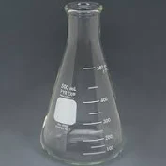
Erlenmeyer Flask
A flask that may be closed with a stopper in order to store samples. These flasks are also useful for mixing solutions for chemical reactions.

Slide 4
Test Tube
Hold, mix or heat small quantities of liquid or solid chemicals for assays and qualitative experiments

Slide 5
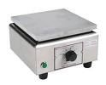
Hot Plate
generally used to heat glassware or its contents

Slide 6
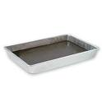
Dissecting Tray
Metal pan filled with tar or paraffin used to hold down specimen with pin.

Slide 7

Forceps
Used to hold or pick up small objects

Slide 8
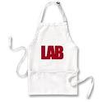
Apron
Protects clothing and possibly skin

Slide 9

Cover slips
Placed over objects that are resting on a slide for viewing with a microscope.

Slide 10
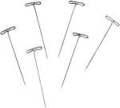
Dissecting Pins
hold the specimen in place during dissection.

Slide 11
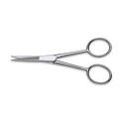
Dissecting Scissors
Scissors that is used in a classroom setting for dissections or in medical and surgical settings.

Slide 12

Scalpel
small and extremely sharp bladed instrument used for surgery, anatomical dissection

Slide 13

Probe
Tool can facilitate the dissection by helping to pin body parts or explore the exposed structure of the object being dissected

Slide 14
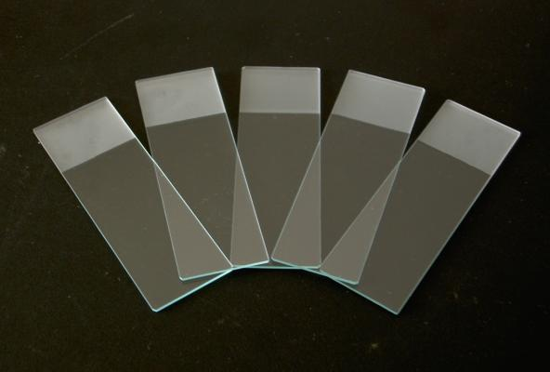
Microscope Slide
Used to hold objects for examination under a microscope

Slide 15
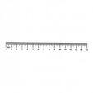
Metric Ruler
Measuring instrument. Always use the metric side of a rules in science.

Slide 16

Goggles
Protect eyes from chemicals and other hazards that exist in a lab setting.

Slide 17

Triple Beam Balance
Used to measure masses very precisely

Slide 18

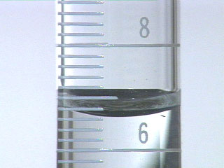
Graduated Cylinder
Used for measuring volumes (amounts) of liquids.
When using this, it is important to read the bottom of the meniscus

Slide 19
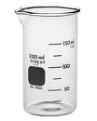
Beaker
Simple container for stirring, mixing and heating liquids

Slide 20
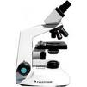
Compound Microscope
Used to observe or analyze microscopic objects.
Can only view samples that light can pass through.

Slide 21
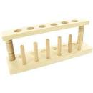
Test Tube Rack
Hold and transport test tubes during experiments or while examining cultures. They can also accommodate other lab tools

Slide 22
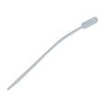
Pipette
Used to transfer small amounts of liquids. The pipette pictured is less accurate though some may have volume marking for 1ml or 2ml.

Slide 23
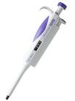
Micropipette
Accurately transfer small volumes of liquids in a laboratory. Pressing on a plunger button at the top of the micropipette will pull the liquid in, and a second press will dispense it.

Slide 24

Thermometer
Measures temperature.

Slide 25

Funnel
Used to channel liquid or fine-grained substances into containers with a small opening.

Slide 26
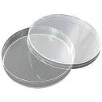
Petri Dish
Used to culture cells or observe some small organisms.

Slide 27
Tools
The equipment used in the lab are simply tools.
Sometimes equipment can be used effectively in a way that it was not designed for.
If it works best for what you are doing then use it!

Slide 28
Analysis
Make sure you have complete the analysis questions.

