Slide 1
Bell Ringer
List three procedures discussed the first day of school.
Notes:
Add anything you want to emphasize for the students. Remind them of the procedure frequently the first 2 weeks.

Slide 2
Experimental Design
Essential Question: How do scientists properly design and carry out an experiment?
Notes:
Designed to integrate with the lessons and activities at USBIOLOGYTEACHING.COM

Slide 3
Scientific Method
Scientific experimentation is carried out with the scientific method in order to able to confidently draw conclusions.
Steps of the Scientific Method
Make an observation and pose a question
Form a hypothesis
Make a prediction
Design an experiment
Analyze Data/ Draw a conclusion

Slide 4
Observation-the act of perceiving using the senses
Let’s see how observant you are.
The next slide will be shown to you for 30 seconds. Record as many observations as you can about the slide.
Ready?
Notes:
Teacher notes: Set a timer for 30 seconds

Slide 5
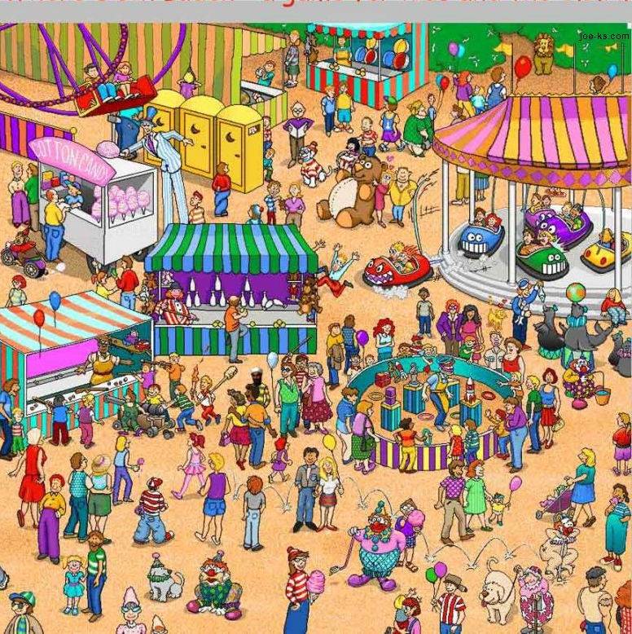
Observation

Slide 6
Observation Questions
What color is the car that is off the carrousel?
red
How many portable toilets are there in the picture?
3
What appears on each door of the portable toilet?
Crescent moon
What animal escaped the zoo?
lion
What are the seals eating?
fish
How many bowling pins are knocked down?
2
Notes:
Students may guess on certain questions like “What are the seals eating” and may be correct. This is a good time to talk about what an inference is.

Slide 7
Hypothesis- a proposed explanation for the way a particular aspect of the natural world functions.
The hypothesis can easily be described as a potential explanation for an observation.
For example: Increasing the amount of time students study will increase the student’s grade in Biology because more exposure to the content will help students remember the content easier.
Notes:
Use the paper folding activity to make connect to the content in the presentation.

Slide 8

Hypothesis Practice
While holding a flashlight you noticed the size of the lighted area was changing as you were walking.
Write a hypothesis proposing what factor is causing the size of the lighted area to change.
Notes:
This would be a great slide to demonstrate using a flashlight/projector. A good answer would be “If the distance from the illuminated object (chalk board?) increases then the size of the illuminated area will increase.”

Slide 9
Prediction- a statement that forecasts what would happen if the hypothesis were true.
A prediction is recorded for each hypothesis.
  Can be written as the “if –then-because” statement.
  Experiment- Used to test the hypothesis by gathering reliable data.
  Many experiments are called controlled experiments. They have:
  Control Group- the normal group or a group that provides a standard for comparison.
  Experimental Group-same as the control group except one factor is changed- (Independent variable)

Slide 10
Variables
Independent Variable-The manipulated variable.
  It is the variable that the experimenter is adding to the experimental group to see how it compares to the control group.
  An easy way to remember it is that the independent variable Changed!
Dependent Variable- the responding variable or what is being measured or counted
Notes:
Refer to the paper folding activity here to make the connections.

Slide 11
Type of Data to Collect
Quantitative Data- measurable using instruments.
  Example: The lighted area is 10cm in diameter when the flashlight is 8cm away from the chalk board.
Qualitative Data-gathered through your senses (sight, smell, hear, touch, taste)
  When the lighted area got bigger students noticed it was more dim.
builder-event

Slide 12
Cautions in Science
Inferences- make a conclusion on the basis of facts and previous knowledge rather than direct observation.
  Waldo Picture- Some of you may have made inferences about what animal escaped the zoo.
Bias-making a judgment based on prior knowledge.

Slide 13
Theory
After a lot of experimentation…..
A scientific theory is a well-substantiated explanation of some aspect of the natural world that is acquired through the scientific method and repeatedly tested and confirmed, preferably using a written, pre-defined, protocol of observations and experiments.

Slide 14
Closing
Tell me one or more things you learned or remember from today?
Notes:
You can also do the beach ball activity for the closing .

