Slide 1

IDENTIFYING MACROMOLECULES IN FOOD
LAB
Biology

Slide 2
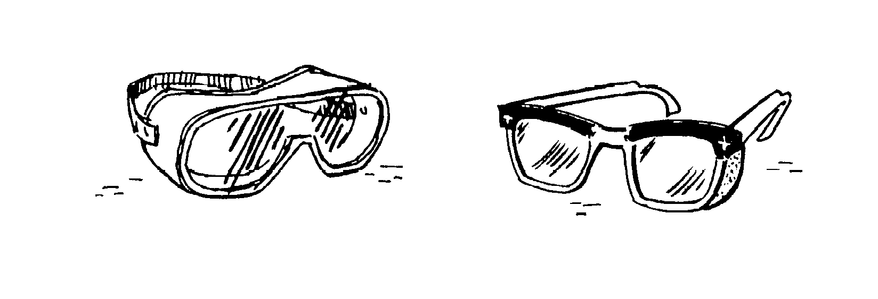
LAB SAFETY and CLEAN UP
NO EDIBLE products in lab
WEAR safety goggles and apron at all times
THOROUGHLY CLEAN lab area and equipment

Slide 3

Introduction
Carbohydrates, proteins, and fats are all essential nutrients.
We cannot manufacture these nutrients so we must obtain them from our environment.

Slide 4

Introduction
In this lab, with the use of indicators as chemical detection tools, you will analyze a variety of foods for the presence of nutrients.
Detection is based upon observing a chemical change that takes place most often a change in color.

Slide 5
Objective
Identify the presence of major nutrients such as simple carbohydrates (glucose), complex carbohydrates (starch), protein (gelatin) and fat (oil) in common foods.

Slide 6
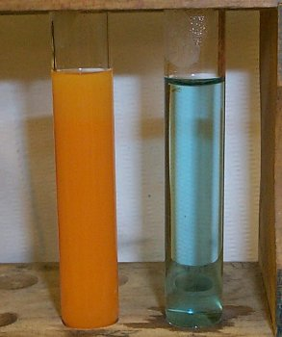
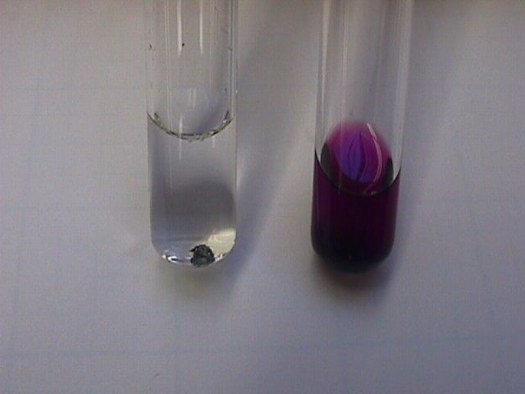
What is an indicator?
Indicators are chemical compounds used to detect the presence of other compounds.

Slide 7
Background Information
INDICATOR | MACRO-MOLECULE | NEGATIVE TEST | POSITIVE TEST
Benedict’s solution | simple carbohydrate | blue | orange
Iodine solution | complex carbohydrate | dark red | black
Biuret solution | protein | blue | violet, black
Sudan IV | lipid | dark red | reddish- orange

Slide 8
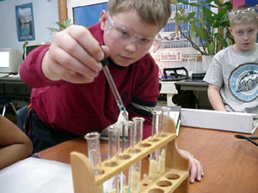
What is a Standard?
An acknowledged measure of comparison for quantitative or qualitative value; a criterion.

Slide 9
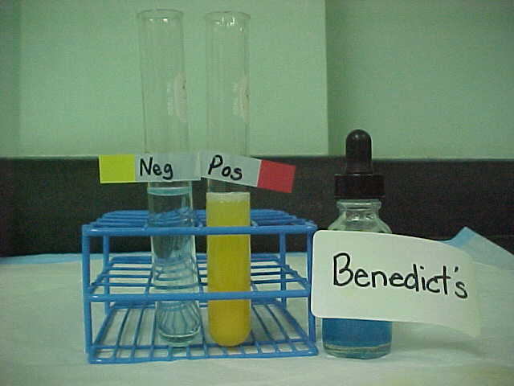
Test for Simple Carbohydrates
Benedict’s solution
Benedict's solution is a chemical indicator for simple sugars such as glucose: C₆H₁₂O₆.
Aqua blue: negative test; yellow/green/brick red, etc.: positive test

Slide 10
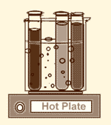
Test for Simple Carbohydrates
Benedict’s solution
Unlike some other indicators, Benedict’s solution does not work at room temperature - it must be heated first.

Slide 11
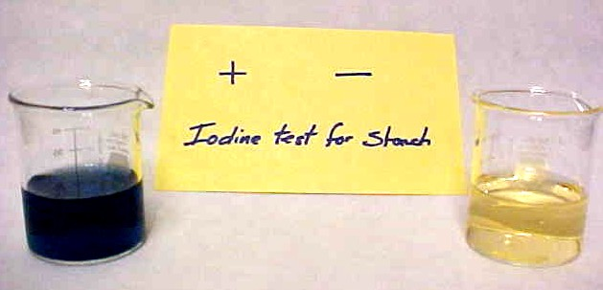
Test for Complex Carbohydrates
Iodine solution
IKI solution → (Iodine Potassium Iodine) color change: Negative= redish-orange; Positive=blue to black

Slide 12
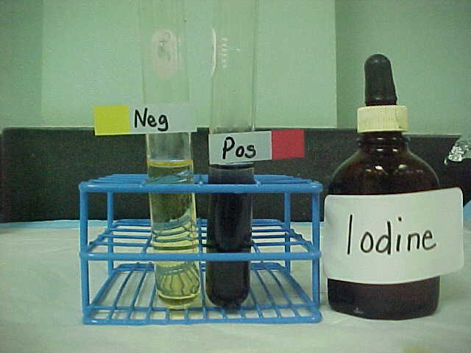
Test for Complex Carbohydrates
Lugol’s solution
Lugol’s solution is an indicator for a molecule called starch.
Starch is a huge molecule made up of hundreds of simple sugar molecules (such as glucose) connected to each other.

Slide 13
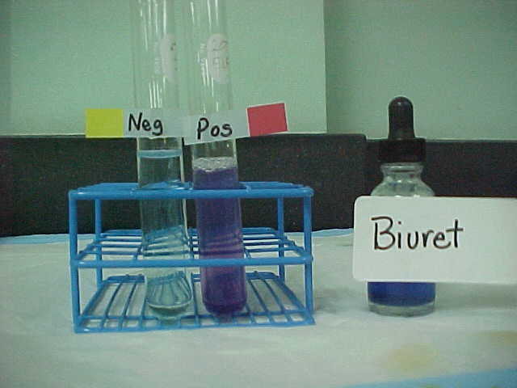
Test for Protein (amino acids)
Biuret solution
Biuret solution → Negative=dark violet blue; Positive=pinkish purple

Slide 14
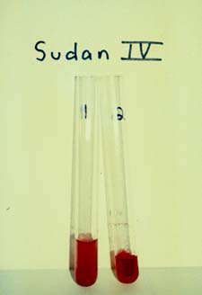
Test for Fats (lipids)
Sudan IV
Like lipids, the chemical Sudan IV is not soluble in water; it is, however, soluble in lipids.
In this test dark red Sudan IV is added to a solution along with ethanol to dissolve any possible lipids.

Slide 15
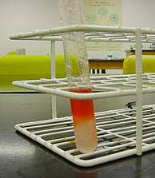
Test for Fats (lipids)
Sudan IV
If lipids are present the Sudan IV will stain them reddish-orange (positive test).

Slide 16
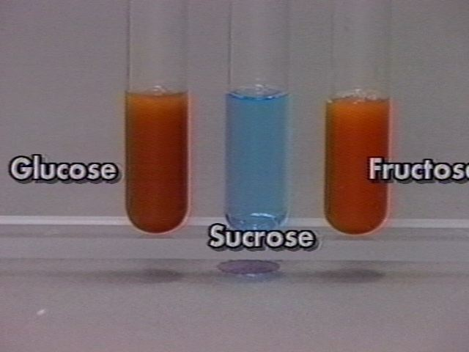
Question
Why didn’t the test tube containing sucrose change colors?

Slide 17
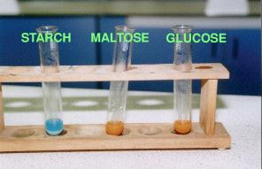
Question
Why didn’t the test tube containing starch change colors?

Slide 18
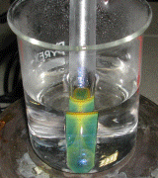
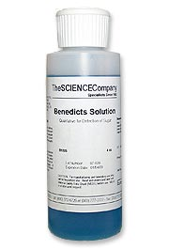
Procedure
Simple carbohydrate
Add 5ml distilled H₂O using pipette to test tube
Add 1ml of glucose sample to test tube
Add 20 drops of Benedict solution
Place test tube in a hot water bath for 10 minutes.

Slide 19
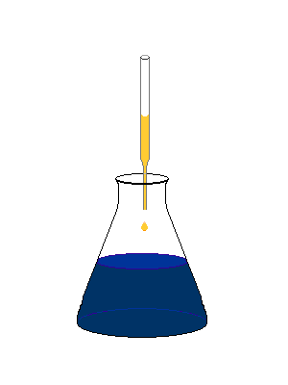
Procedure
Complex carbohydrate
Add 5ml distilled H₂O using pipette to test tube
Add 1ml of starch sample to test tube
Add 20 drops of iodine solution

Slide 20
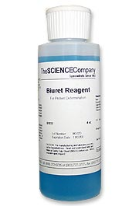
Procedure
Protein (amino acids)
Add 5ml distilled H₂O using pipette to test tube
Add 1ml of gelatin sample to test tube
Add 20 drops of Biuret solution

Slide 21
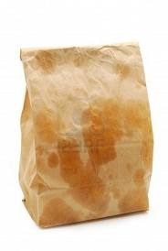
Procedure
Fats (lipids)
Add 1 drop of vegetable to piece of brown paper.
Determine if the paper is translucent to light (positive) or opaque (negative).

